Slide 1
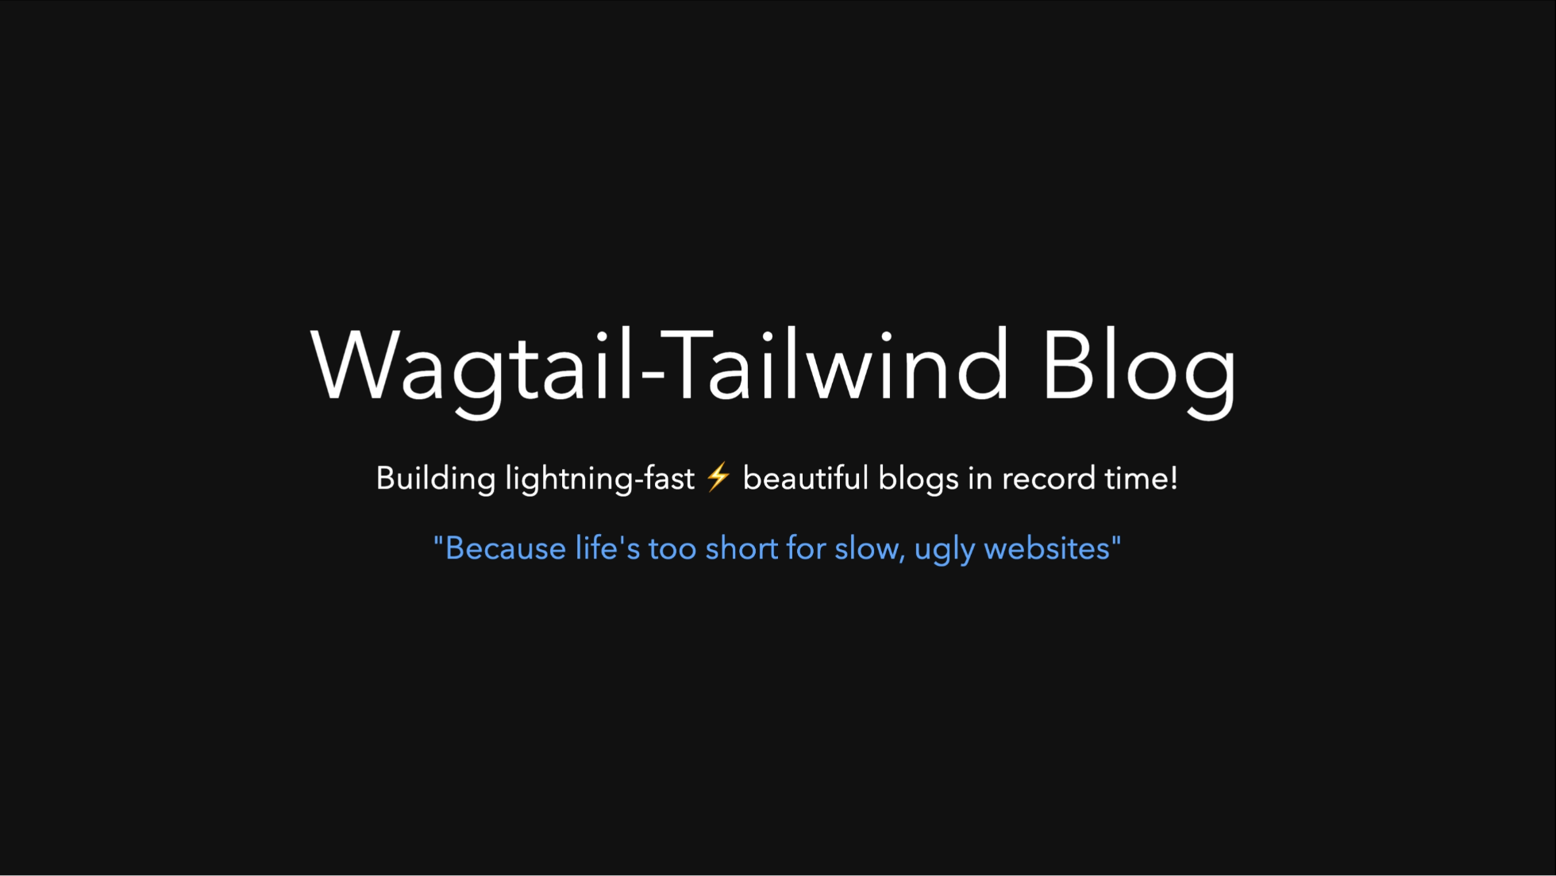

Slide 2
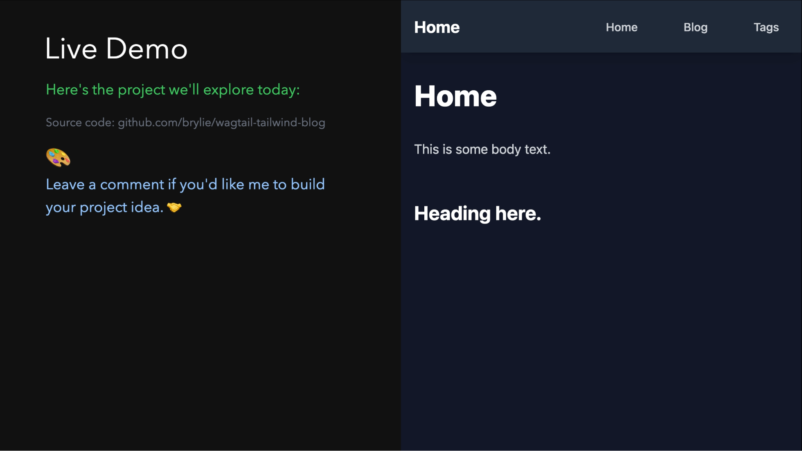

Slide 3
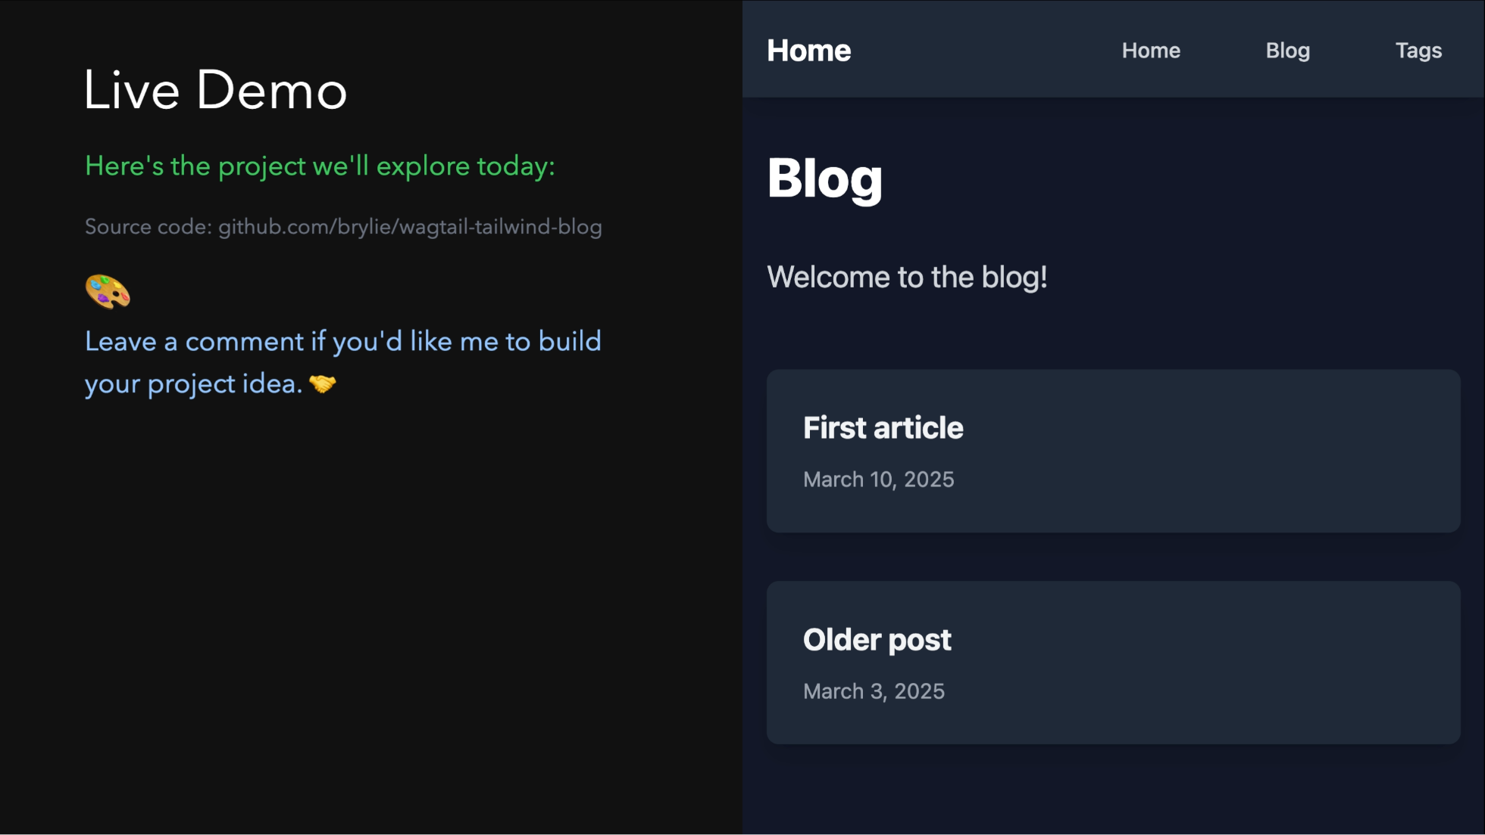

Slide 4
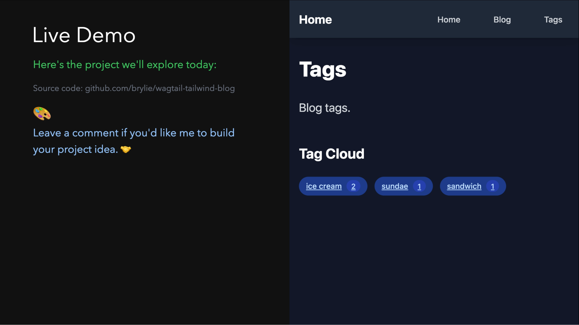

Slide 5
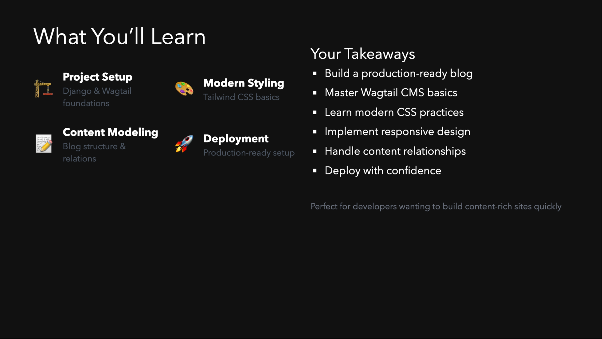

Slide 6
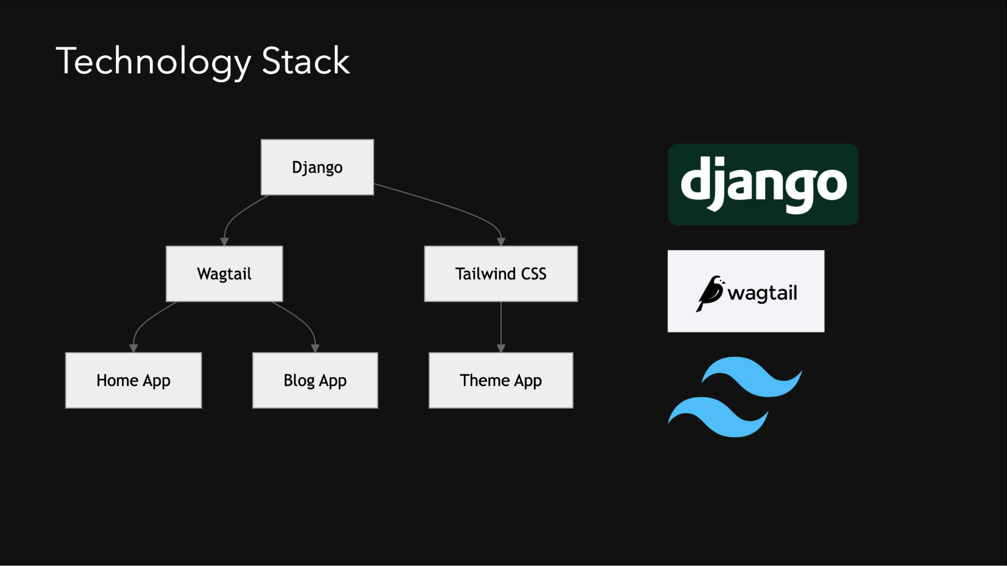
Notes:
Our technology stack consists of: - Django - The web framework providing our foundation - Wagtail - A powerful, flexible CMS built on Django - Tailwind CSS - A utility-first CSS framework - django-tailwind - Package for seamless Tailwind integration What we'll build: - Home page with rich text content - Blog with tagging functionality - Responsive, modern UI with Tailwind

Slide 7
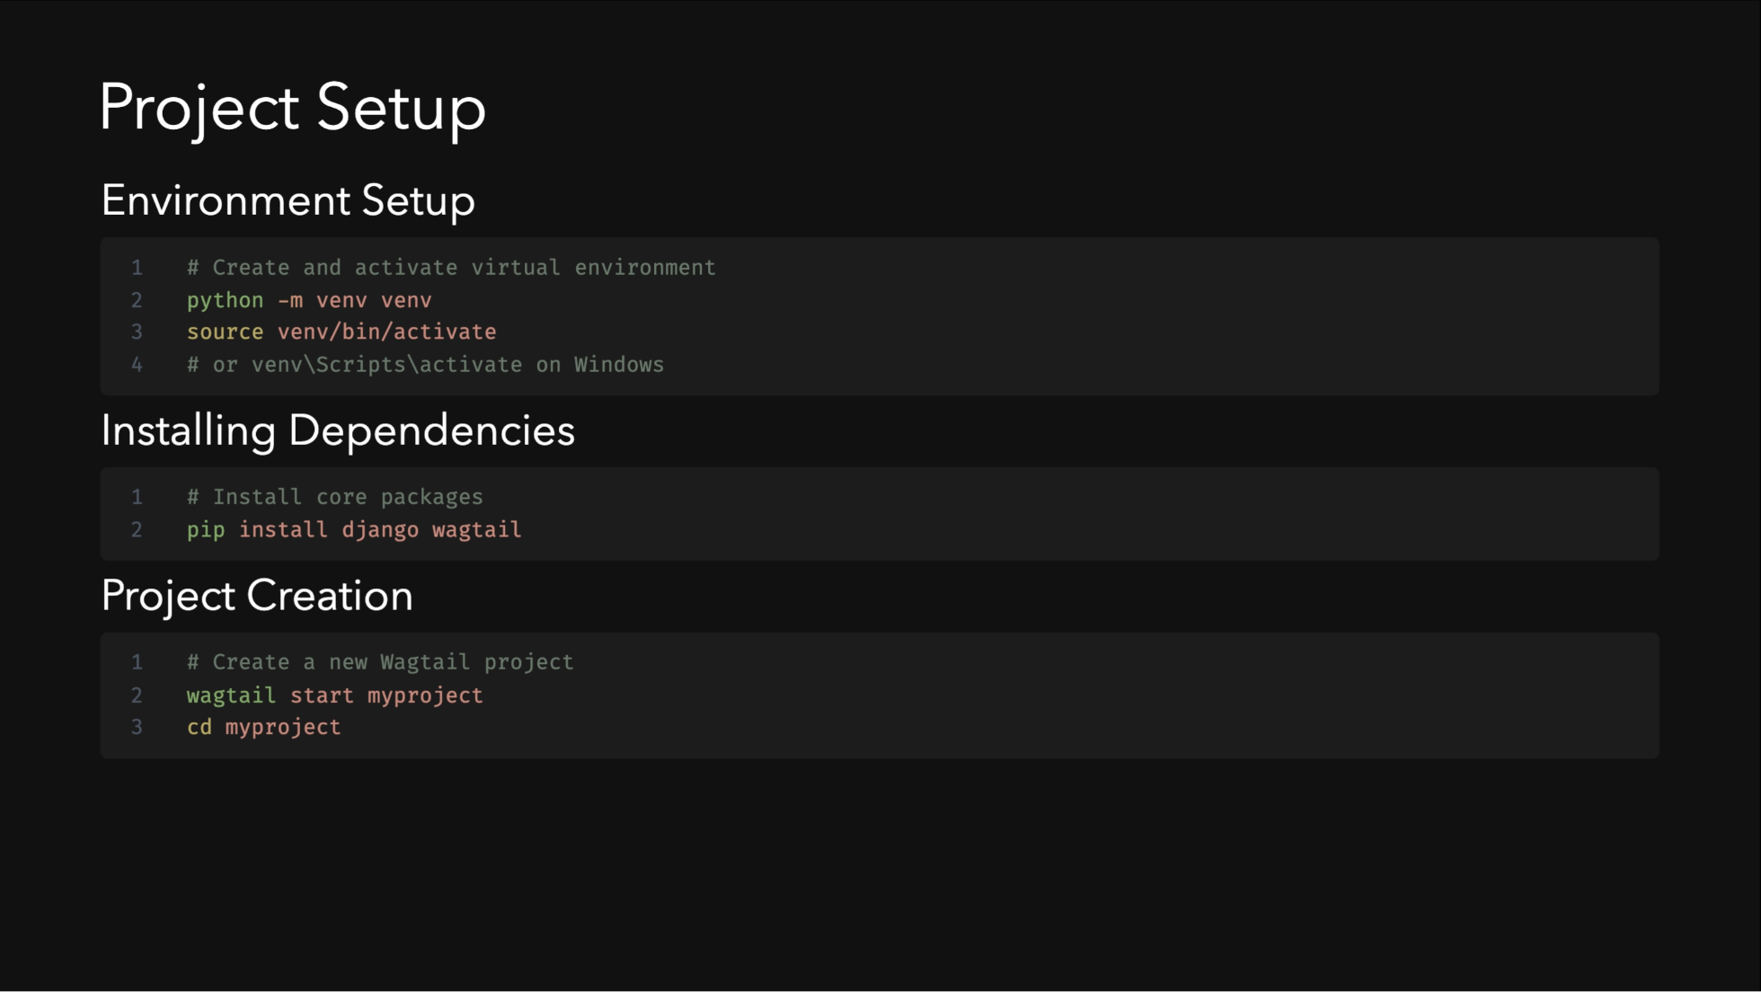
Notes:
Let's start by setting up our development environment: 1. We first create a virtual environment to isolate our dependencies 2. Then we install the core packages - Django, Wagtail, and django-tailwind - The [reload] option enables hot reloading during development 3. We create a new Wagtail project using the CLI tool 4. Initialize the database with migrations 5. Create an admin user to access the CMS 6. Start the development server to see our project These steps give us a working foundation to build upon.

Slide 8
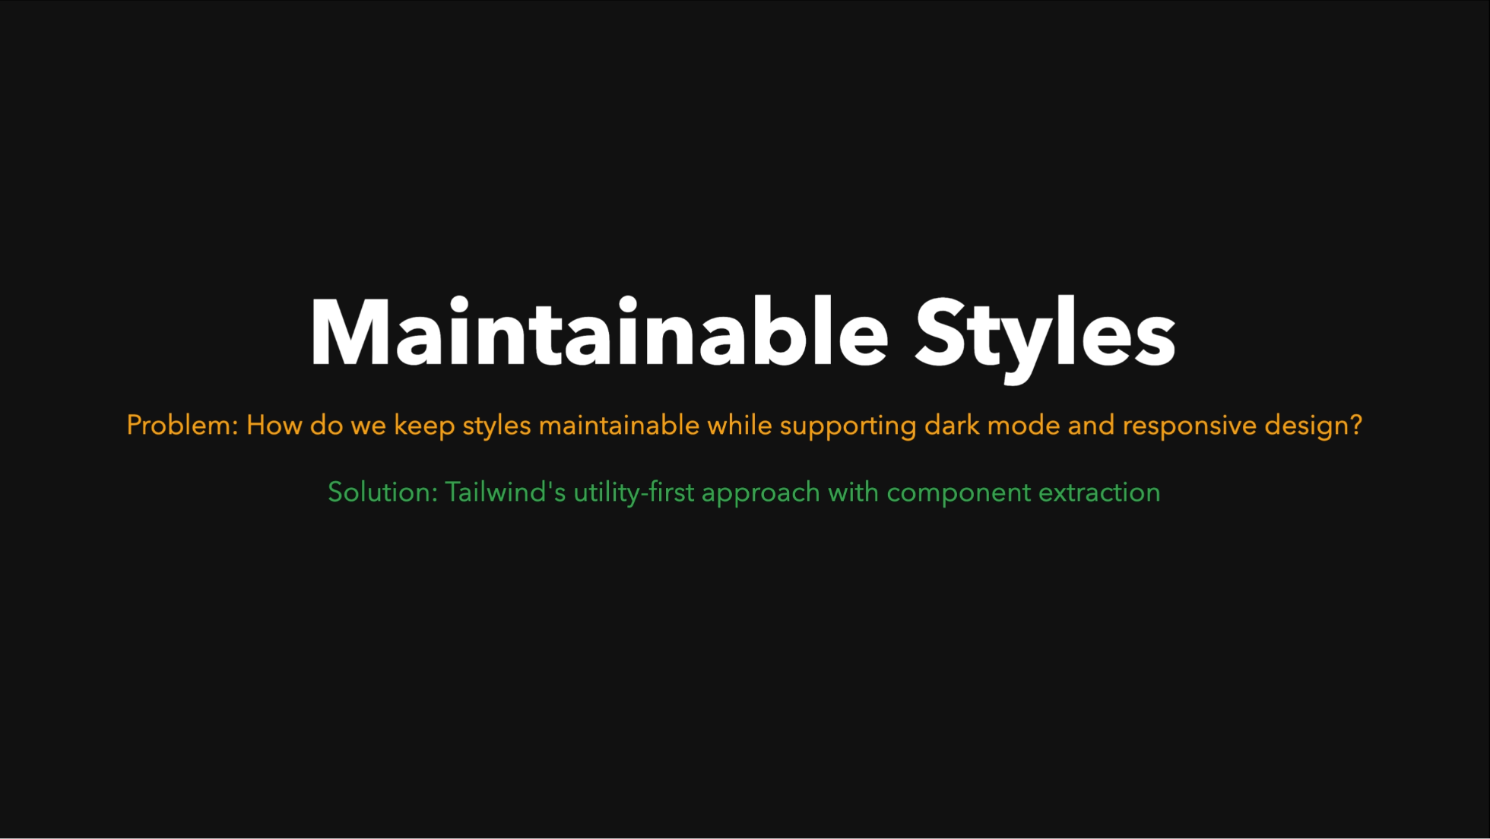
Notes:
Tailwind makes styling straightforward with utility classes. The prose plugin is particularly useful for blog content. Dark mode is handled with dark: prefixed classes, making theme implementation simpler.

Slide 9
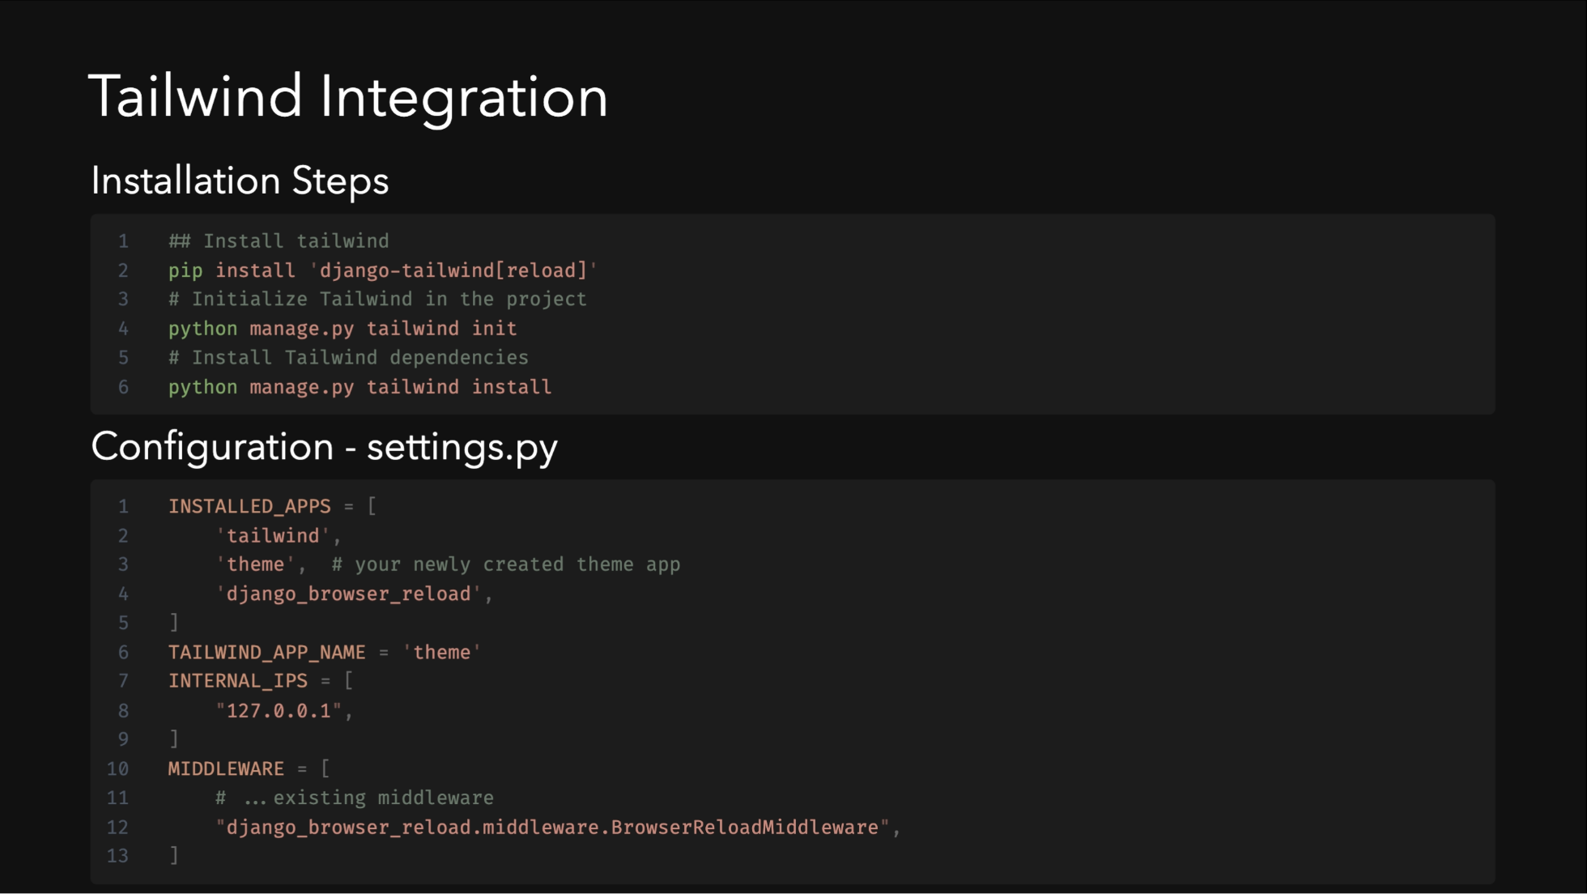

Slide 10
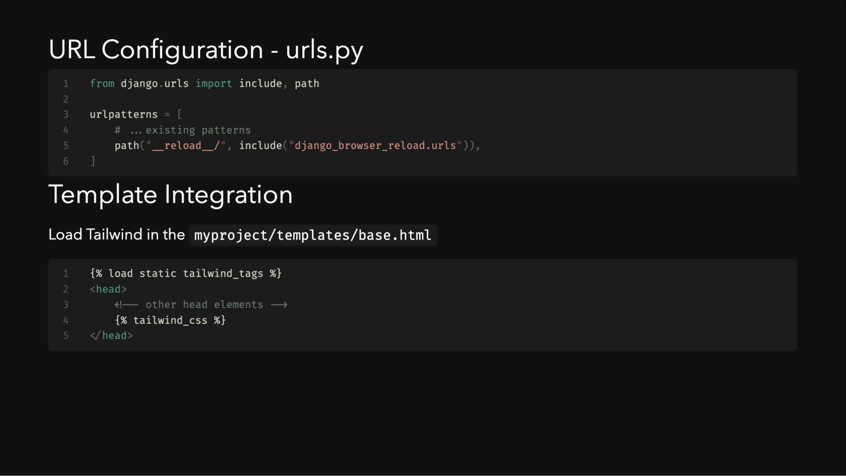
Notes:
Tailwind integration requires several configuration steps, but the django-tailwind package makes it relatively straightforward. The browser reload configuration enables hot reloading during development.

Slide 11
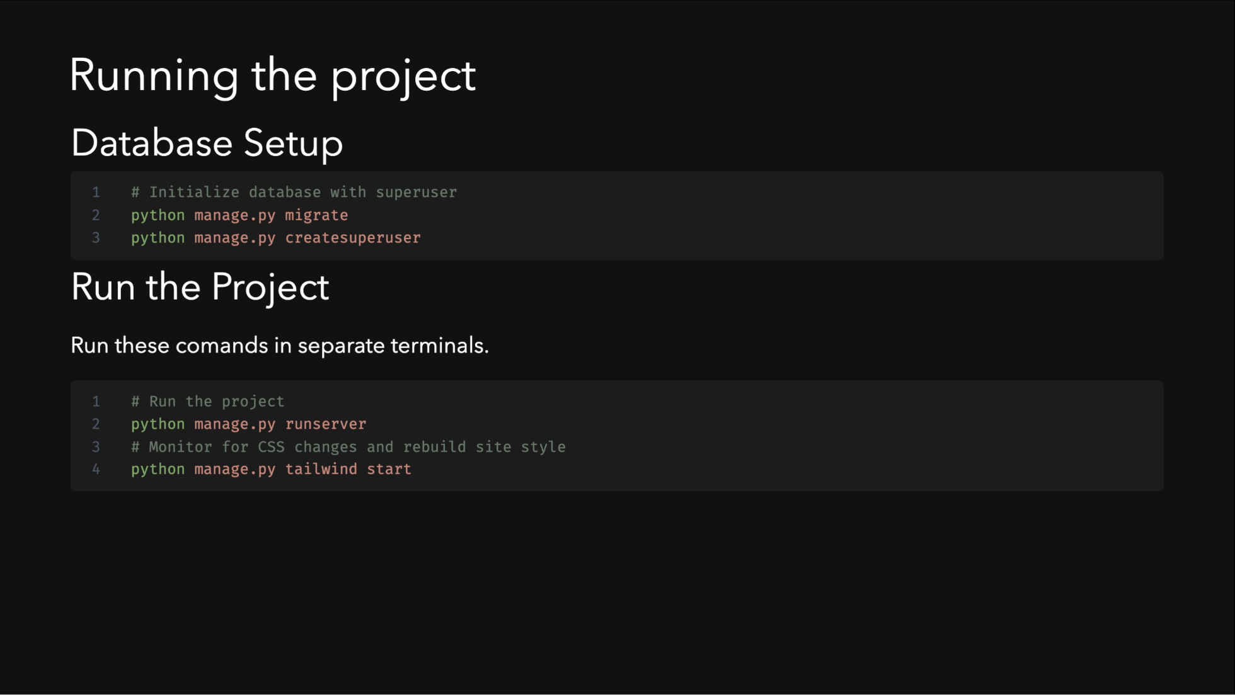
Notes:
Tailwind integration requires several configuration steps, but the django-tailwind package makes it relatively straightforward. The browser reload configuration enables hot reloading during development.

Slide 12
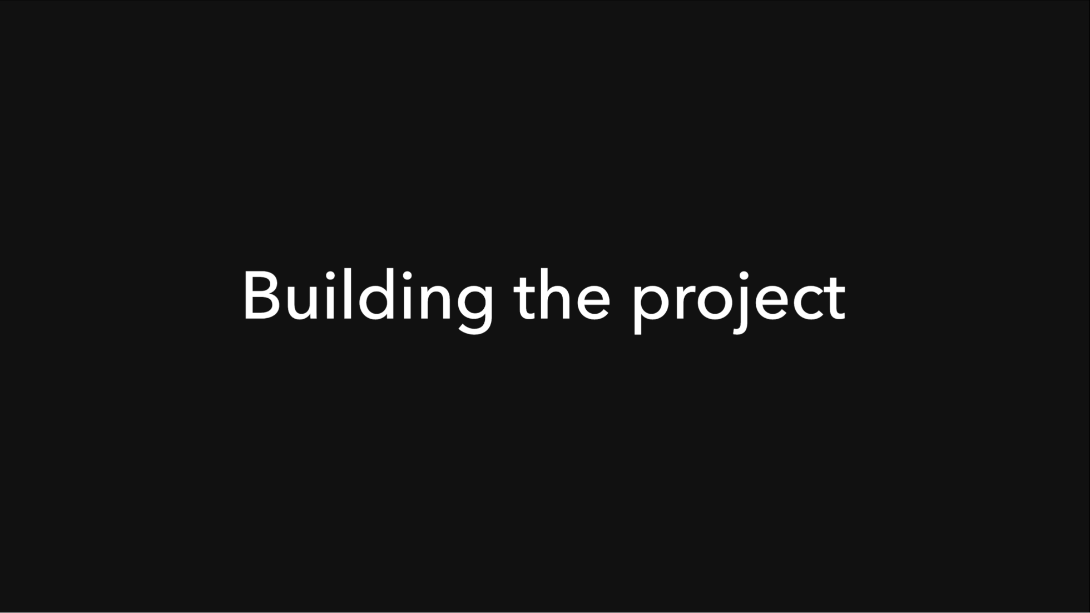

Slide 13
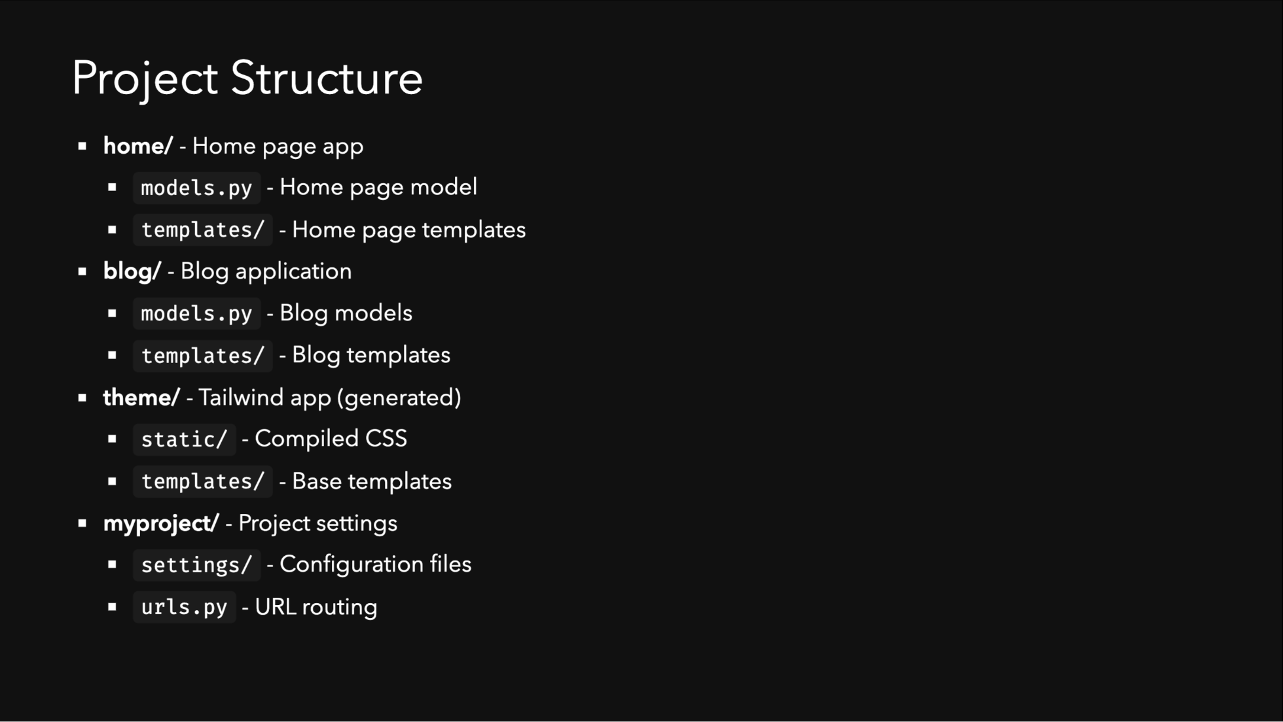
Notes:
This is the high-level structure of our project. We'll explore each of these components in detail.

Slide 14
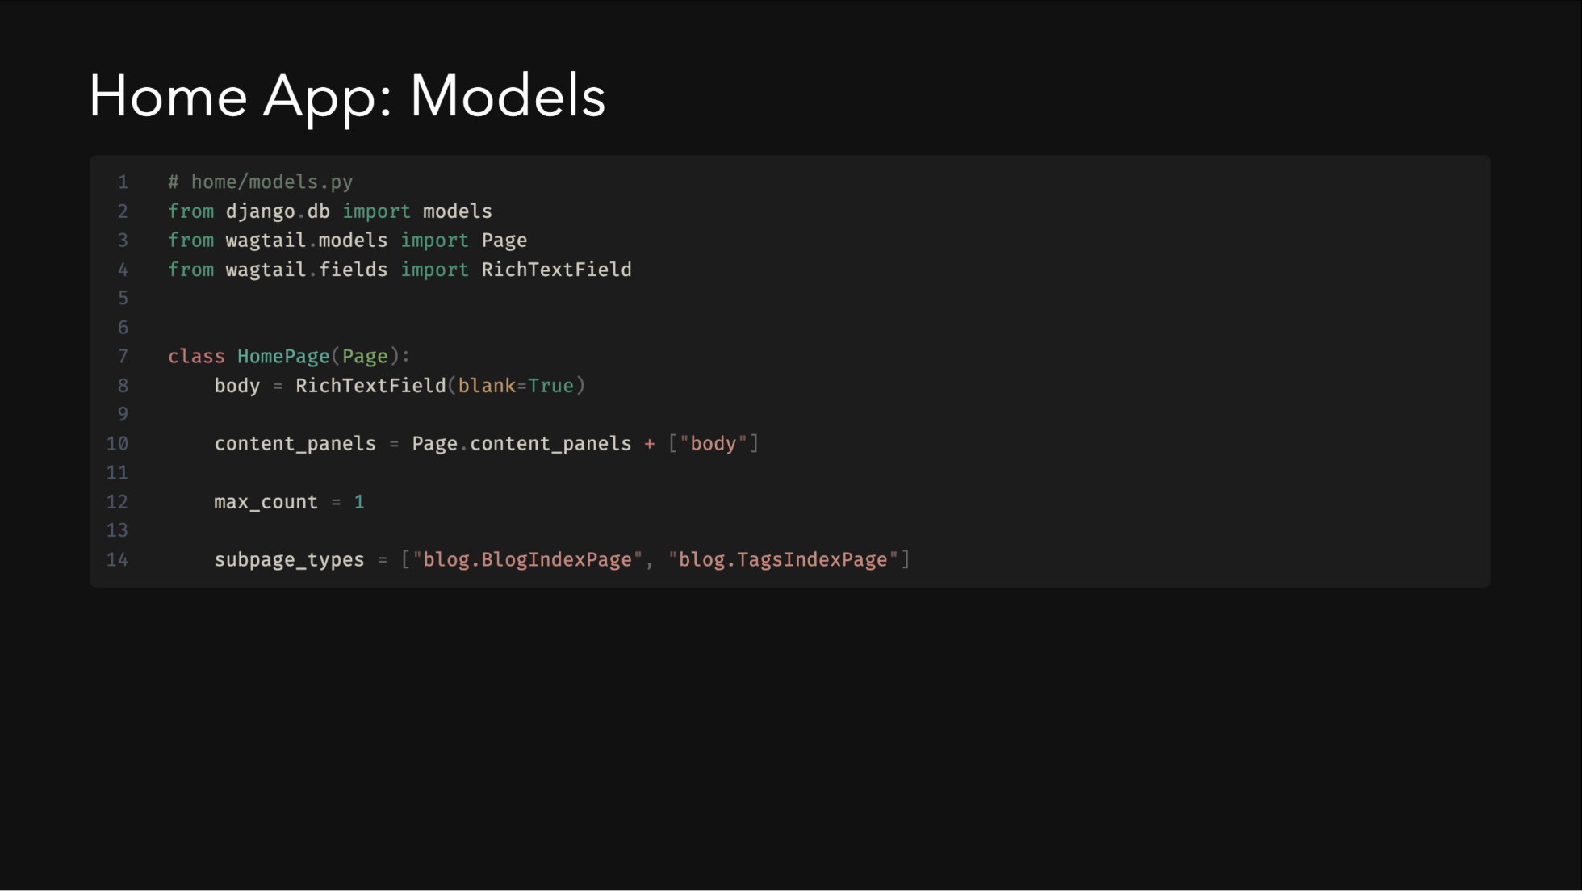
Notes:
- Extends Wagtail's `Page` model - `RichTextField` for content editing - `max_count = 1` ensures only one home page - `subpage_types` defines allowed child pages

Slide 15
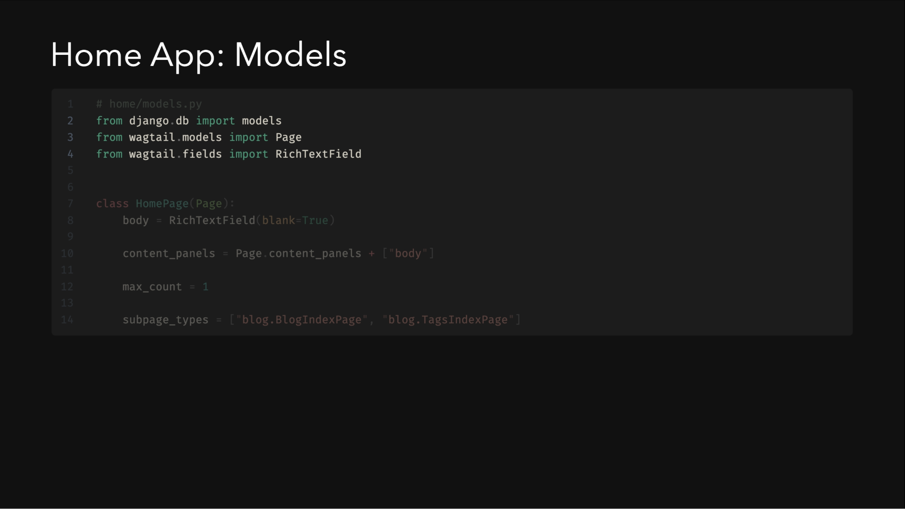
Notes:
- Extends Wagtail's `Page` model - `RichTextField` for content editing - `max_count = 1` ensures only one home page - `subpage_types` defines allowed child pages

Slide 16
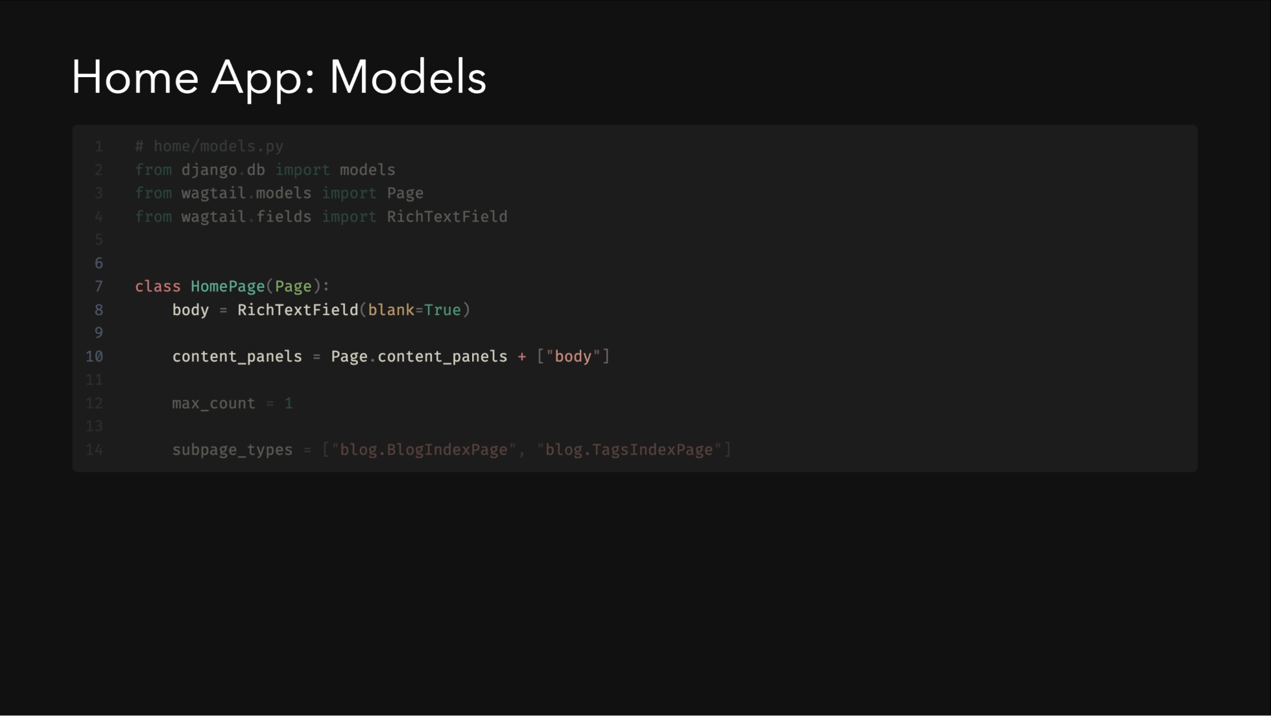
Notes:
- Extends Wagtail's `Page` model - `RichTextField` for content editing - `max_count = 1` ensures only one home page - `subpage_types` defines allowed child pages

Slide 17
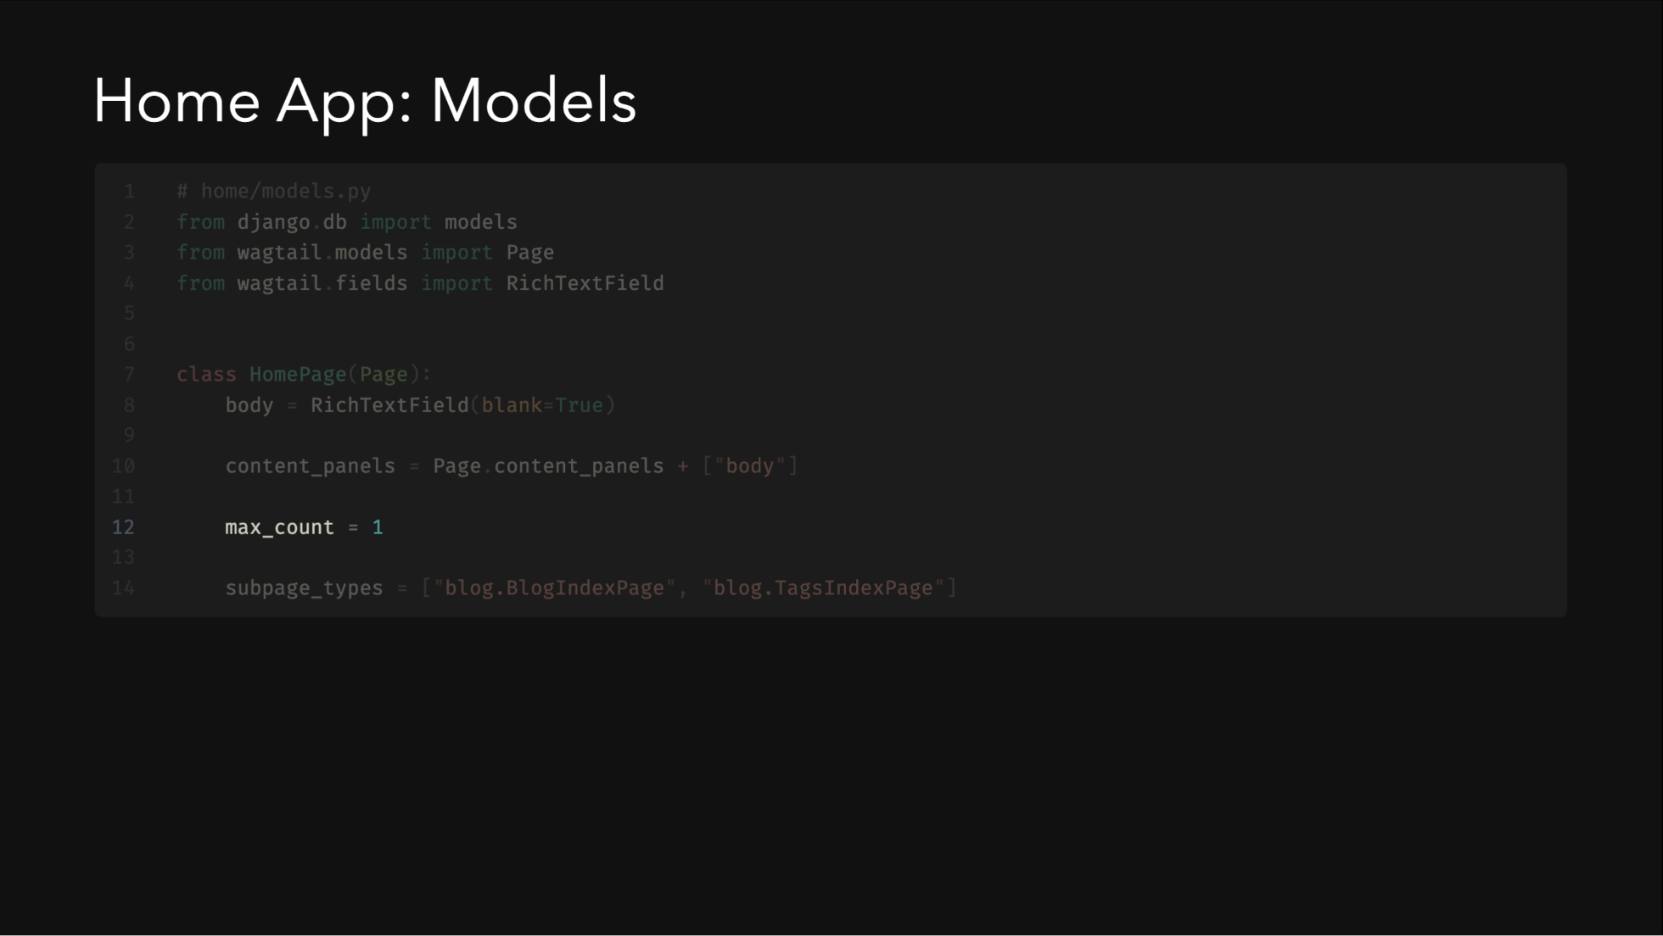
Notes:
- Extends Wagtail's `Page` model - `RichTextField` for content editing - `max_count = 1` ensures only one home page - `subpage_types` defines allowed child pages

Slide 18
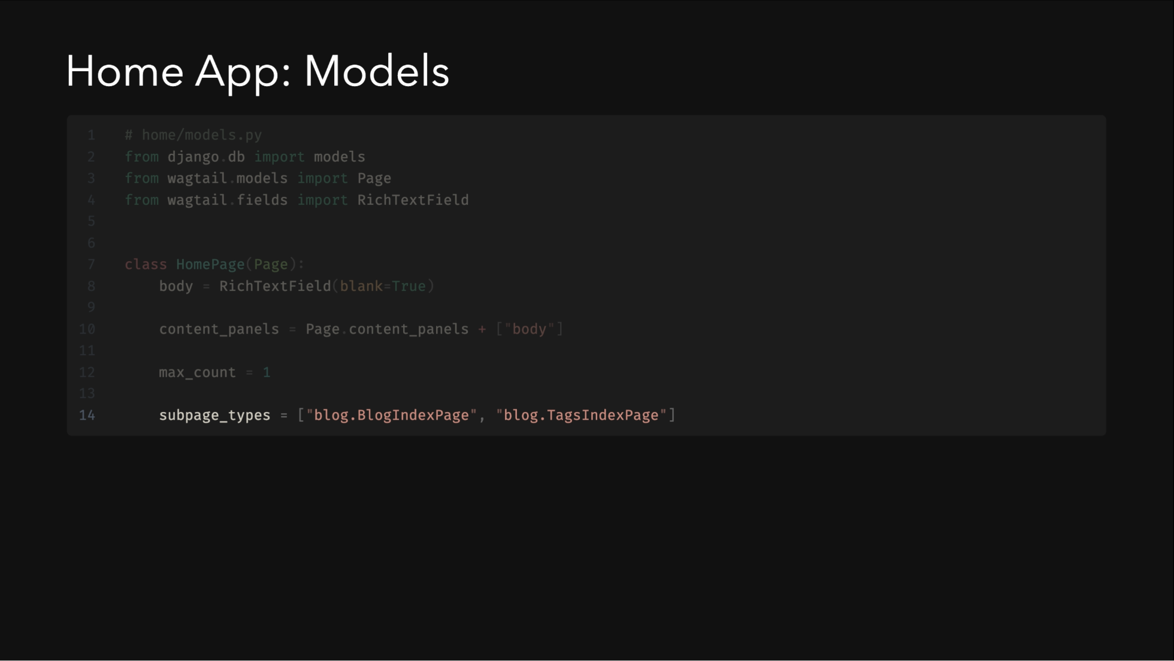
Notes:
- Extends Wagtail's `Page` model - `RichTextField` for content editing - `max_count = 1` ensures only one home page - `subpage_types` defines allowed child pages

Slide 19
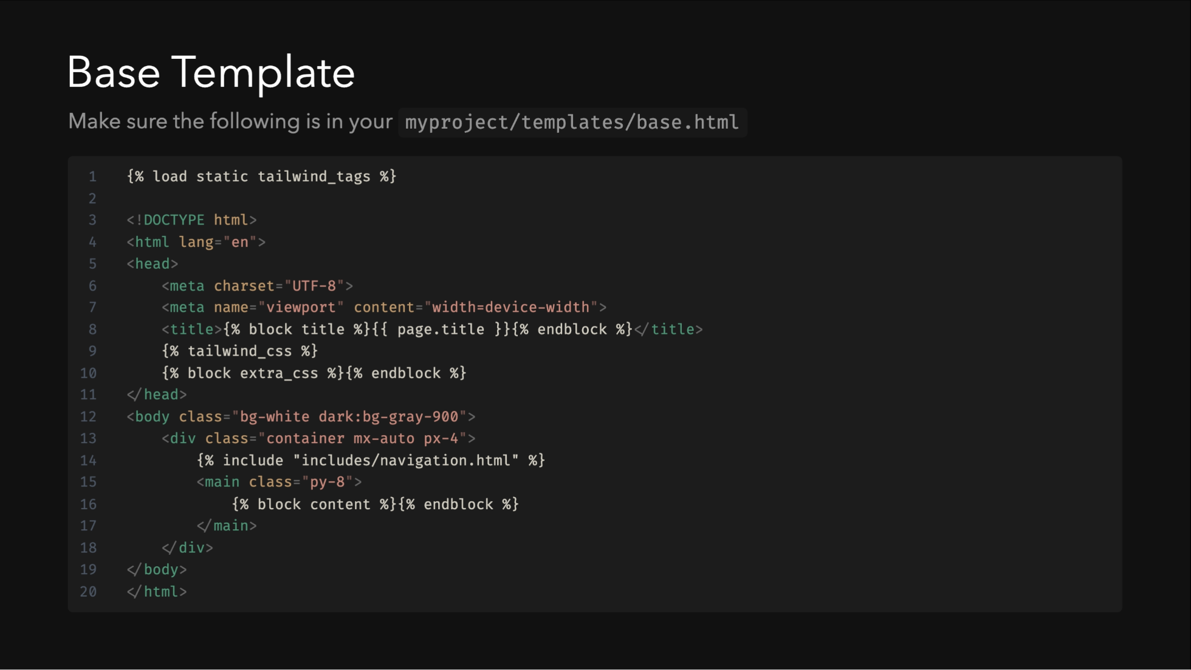
Notes:
The base template provides the foundation for all pages. Note how we use template inheritance and blocks for flexibility.

Slide 20
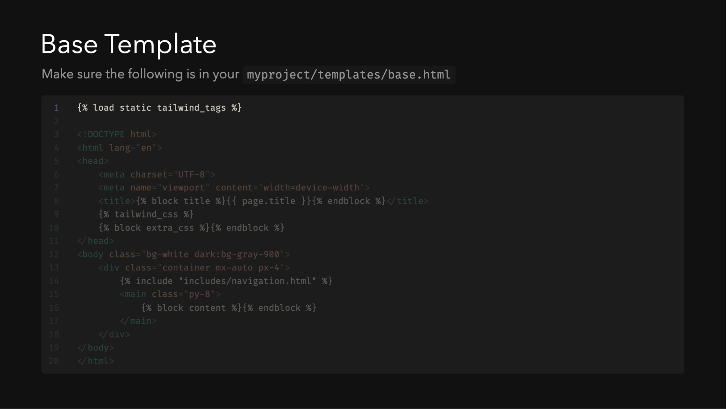
Notes:
The base template provides the foundation for all pages. Note how we use template inheritance and blocks for flexibility.

Slide 21
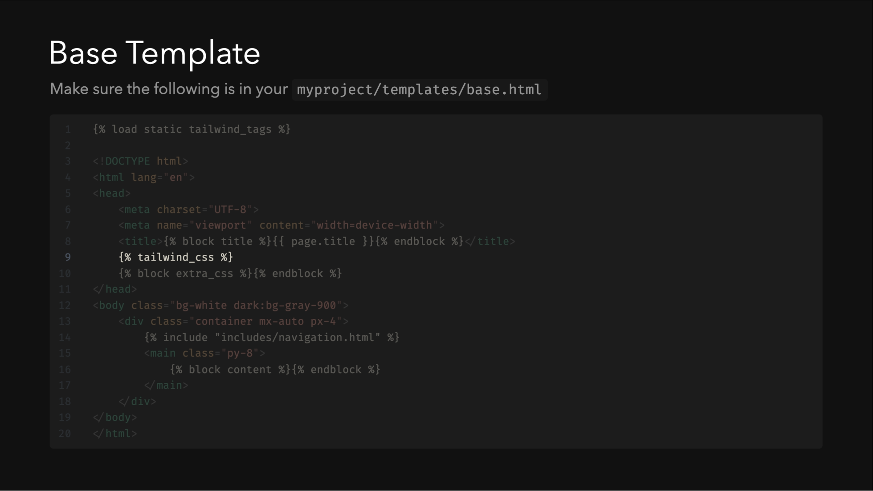
Notes:
The base template provides the foundation for all pages. Note how we use template inheritance and blocks for flexibility.

Slide 22
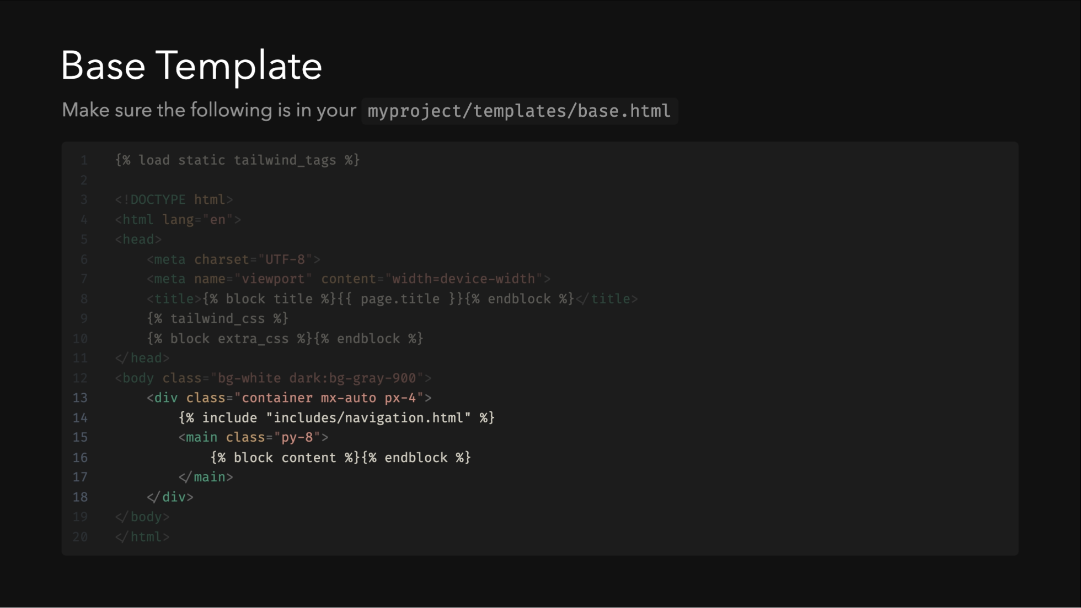
Notes:
The base template provides the foundation for all pages. Note how we use template inheritance and blocks for flexibility.

Slide 23
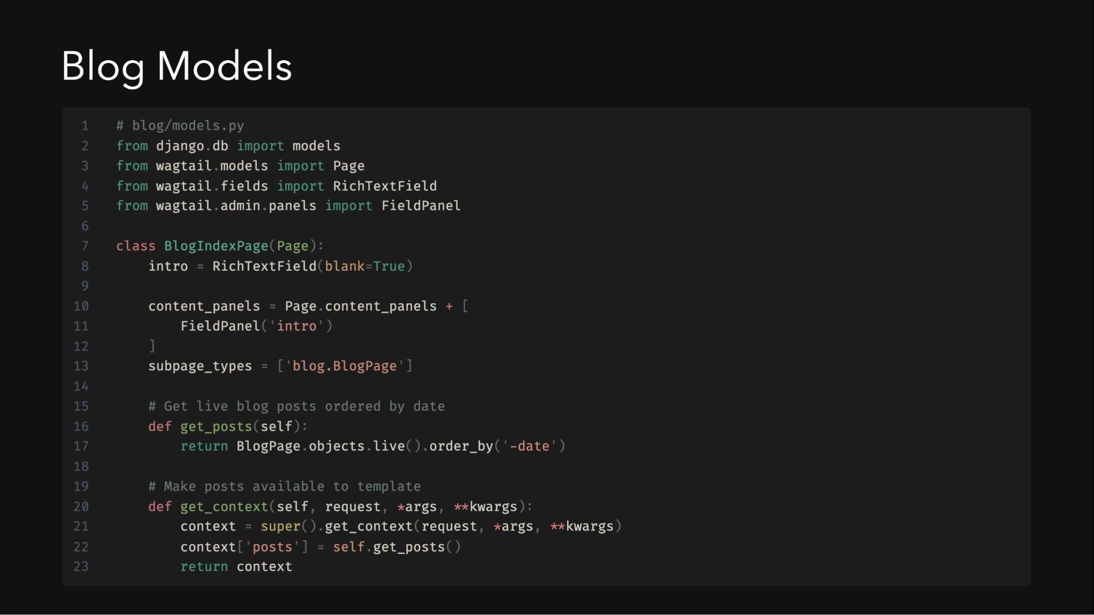
Notes:
The BlogIndexPage serves as a container and listing page for blog posts. It demonstrates Wagtail's powerful context manipulation to provide data to templates.

Slide 24
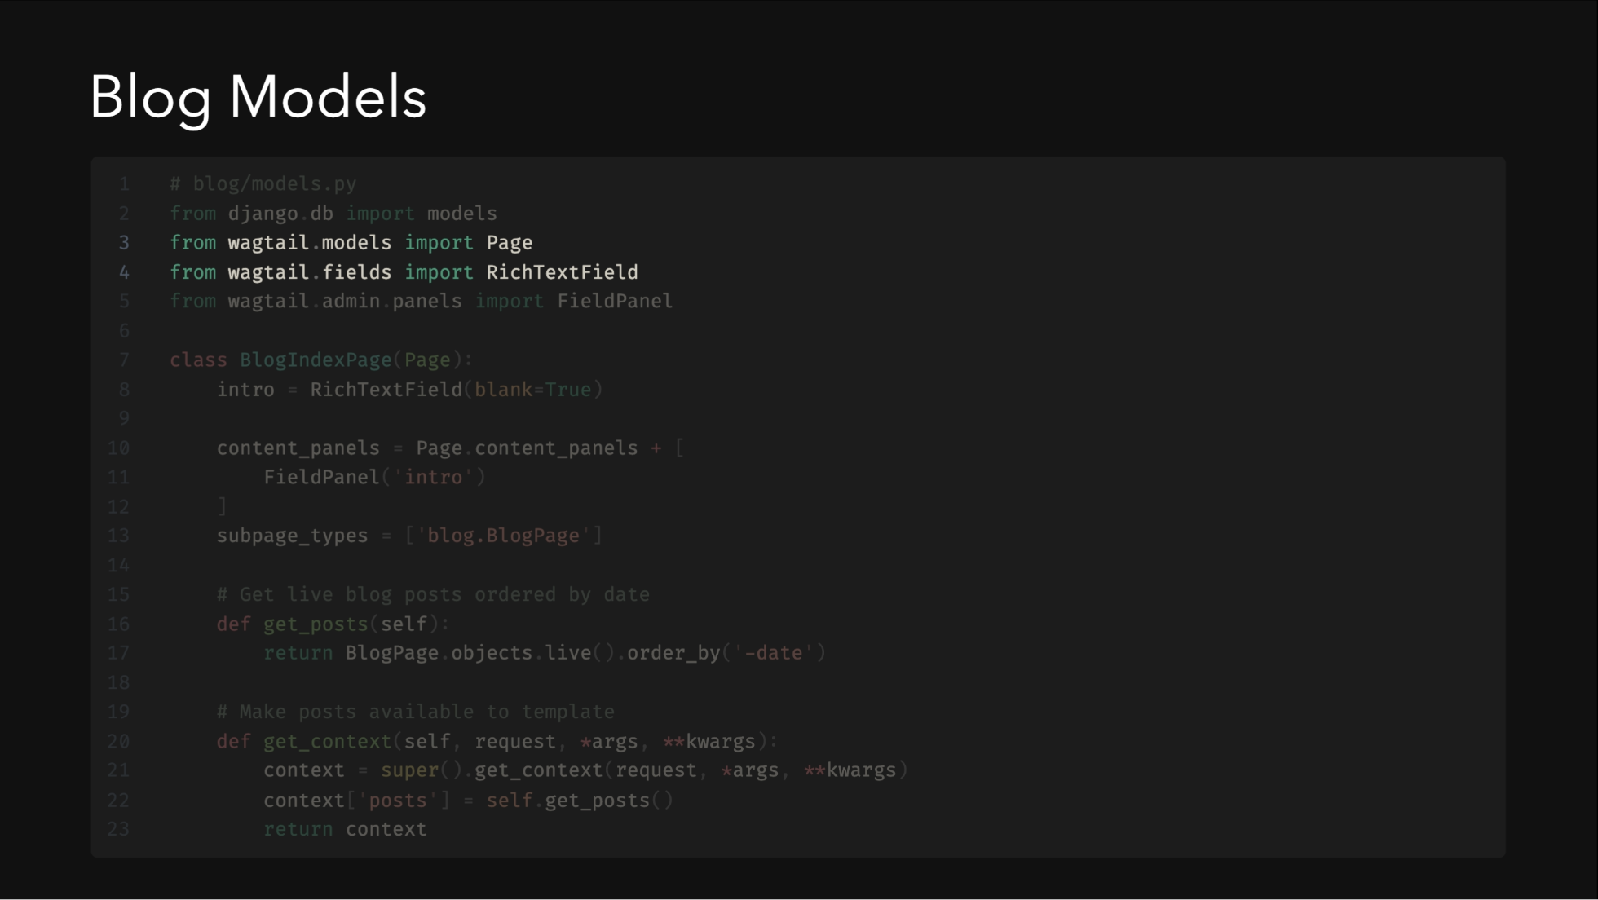
Notes:
The BlogIndexPage serves as a container and listing page for blog posts. It demonstrates Wagtail's powerful context manipulation to provide data to templates.

Slide 25
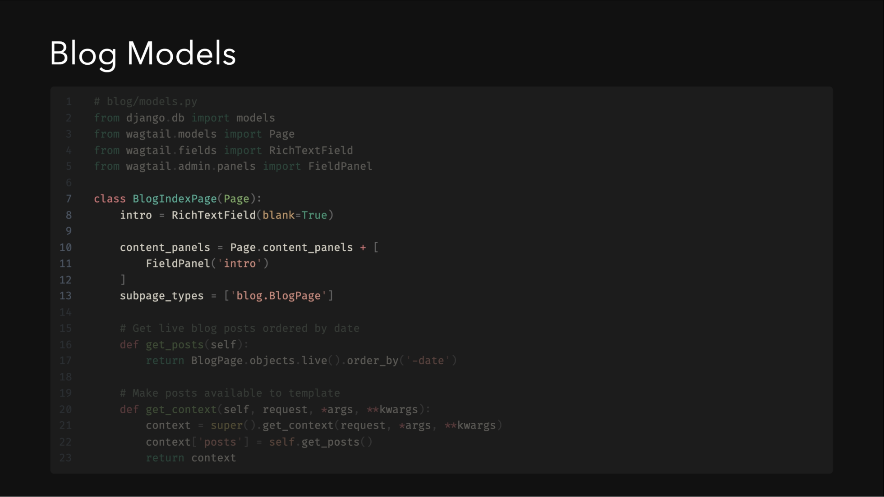
Notes:
The BlogIndexPage serves as a container and listing page for blog posts. It demonstrates Wagtail's powerful context manipulation to provide data to templates.

Slide 26
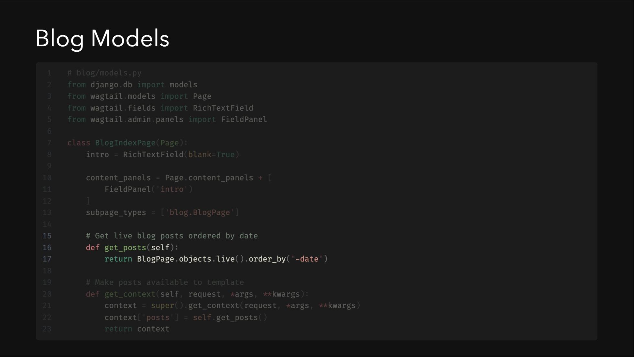
Notes:
The BlogIndexPage serves as a container and listing page for blog posts. It demonstrates Wagtail's powerful context manipulation to provide data to templates.

Slide 27
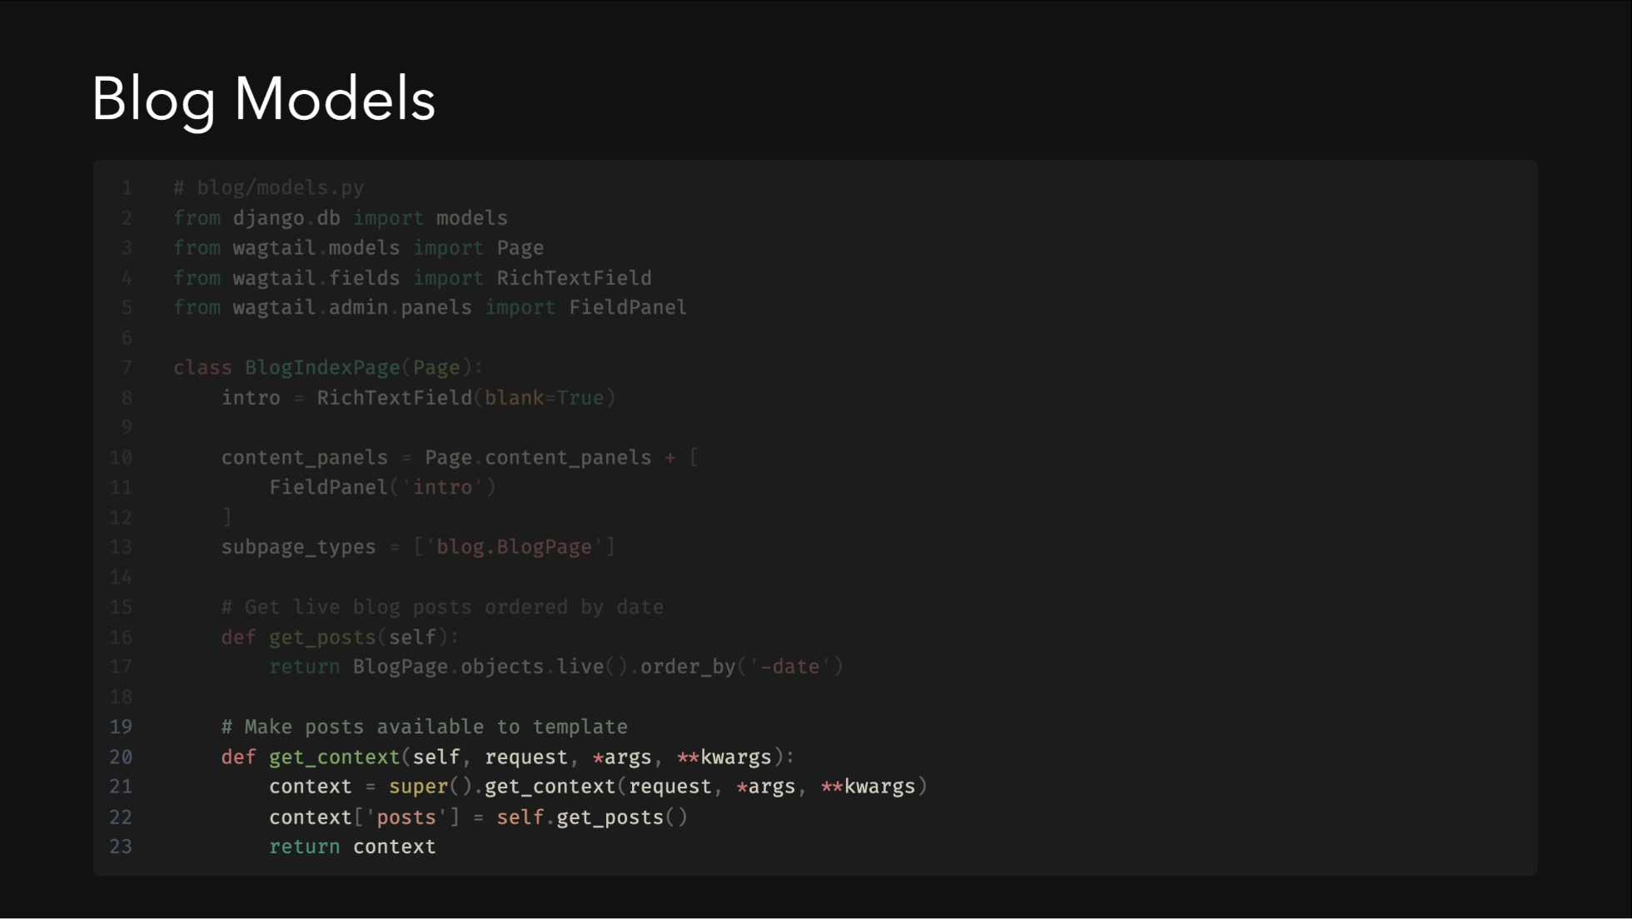
Notes:
The BlogIndexPage serves as a container and listing page for blog posts. It demonstrates Wagtail's powerful context manipulation to provide data to templates.

Slide 28
Notes:
The BlogIndexPage serves as a container and listing page for blog posts. It demonstrates Wagtail's powerful context manipulation to provide data to templates.

Slide 29
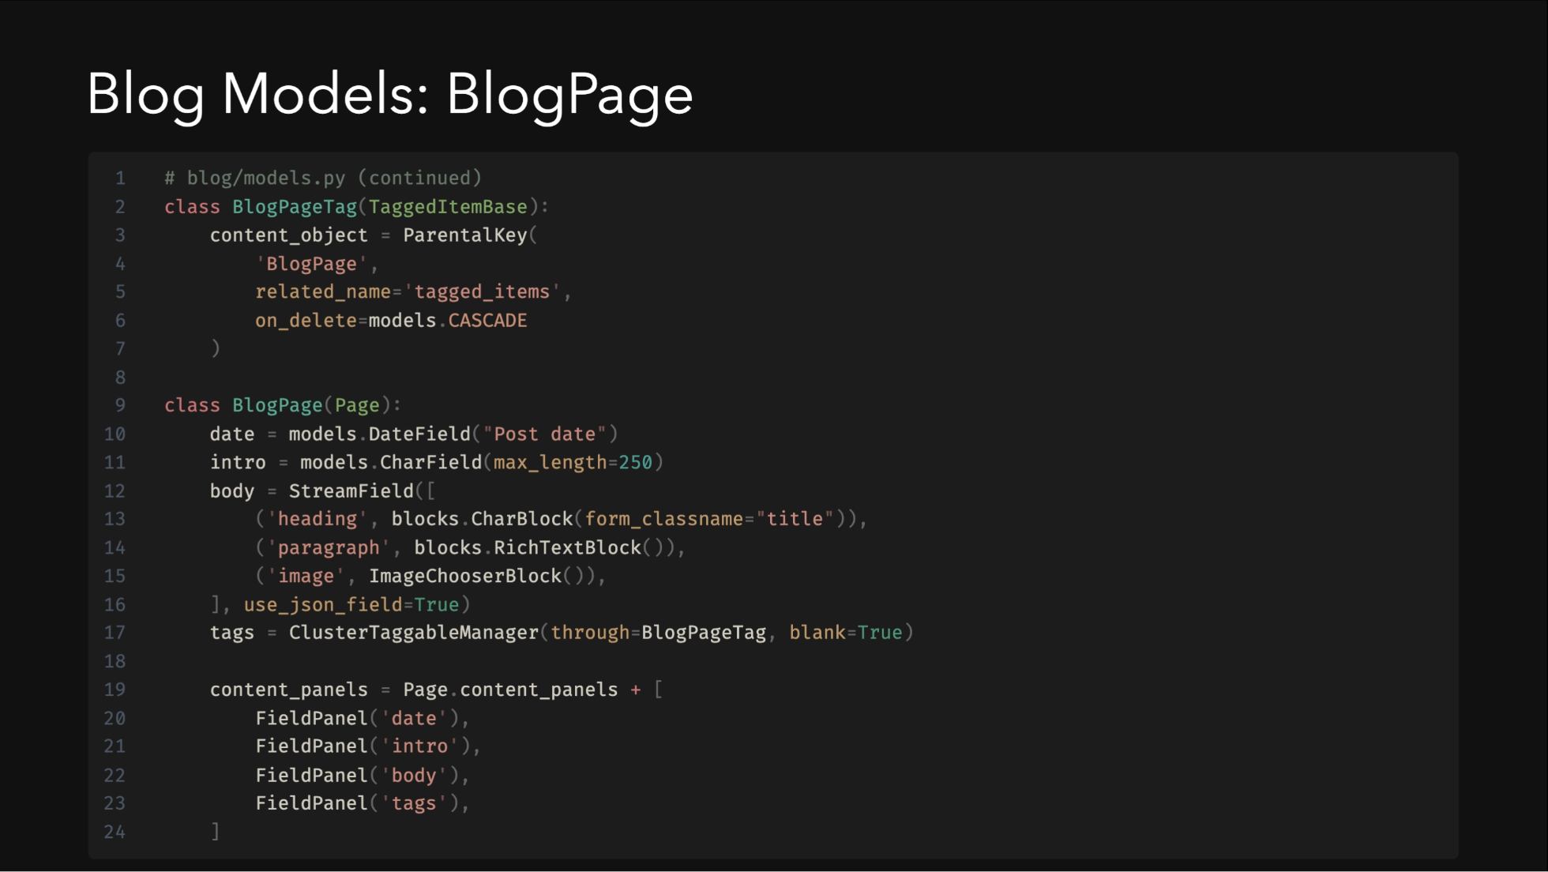
Notes:
The BlogPage model is more complex, featuring StreamField for flexible content and tagging functionality. StreamField allows editors to build pages from predefined content blocks in any order they choose.

Slide 30
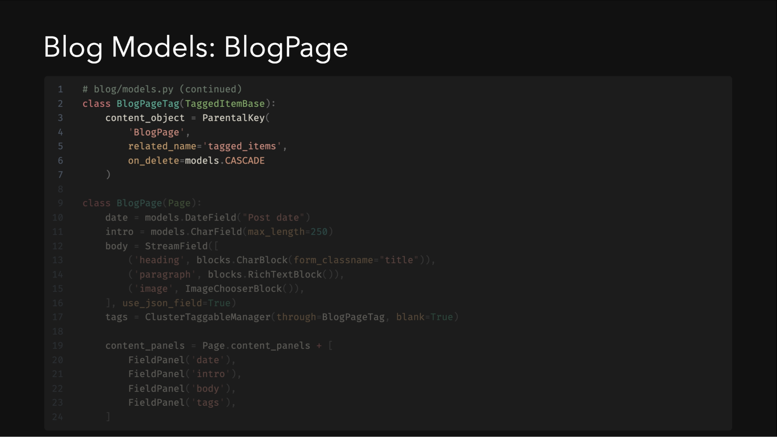
Notes:
The BlogPage model is more complex, featuring StreamField for flexible content and tagging functionality. StreamField allows editors to build pages from predefined content blocks in any order they choose.

Slide 31
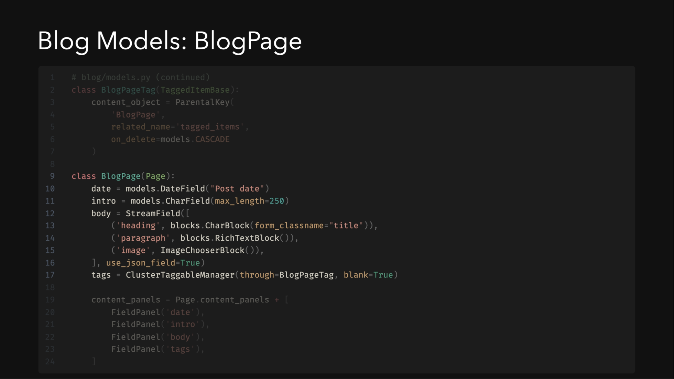
Notes:
The BlogPage model is more complex, featuring StreamField for flexible content and tagging functionality. StreamField allows editors to build pages from predefined content blocks in any order they choose.

Slide 32
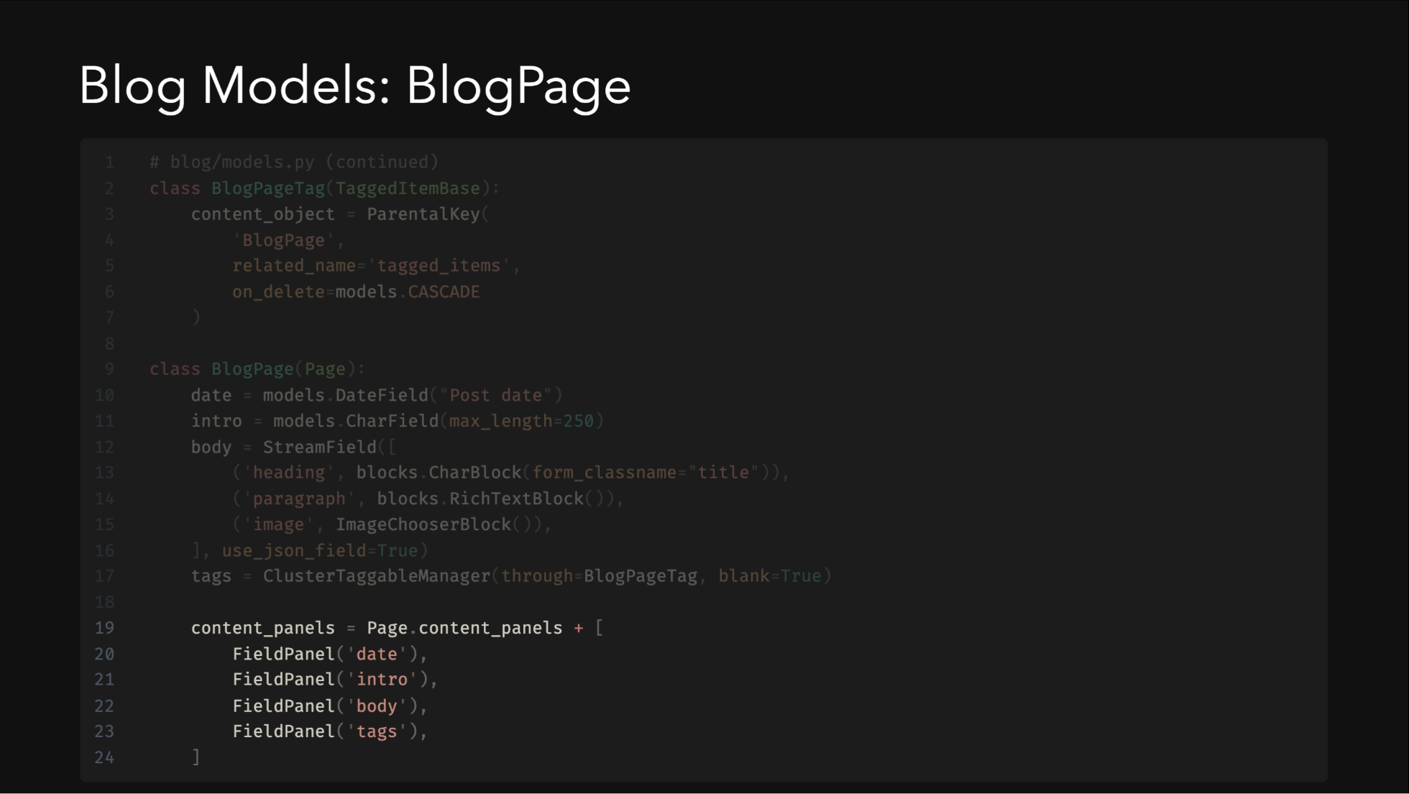
Notes:
The BlogPage model is more complex, featuring StreamField for flexible content and tagging functionality. StreamField allows editors to build pages from predefined content blocks in any order they choose.

Slide 33
Notes:
The BlogPage model is more complex, featuring StreamField for flexible content and tagging functionality. StreamField allows editors to build pages from predefined content blocks in any order they choose.

Slide 34
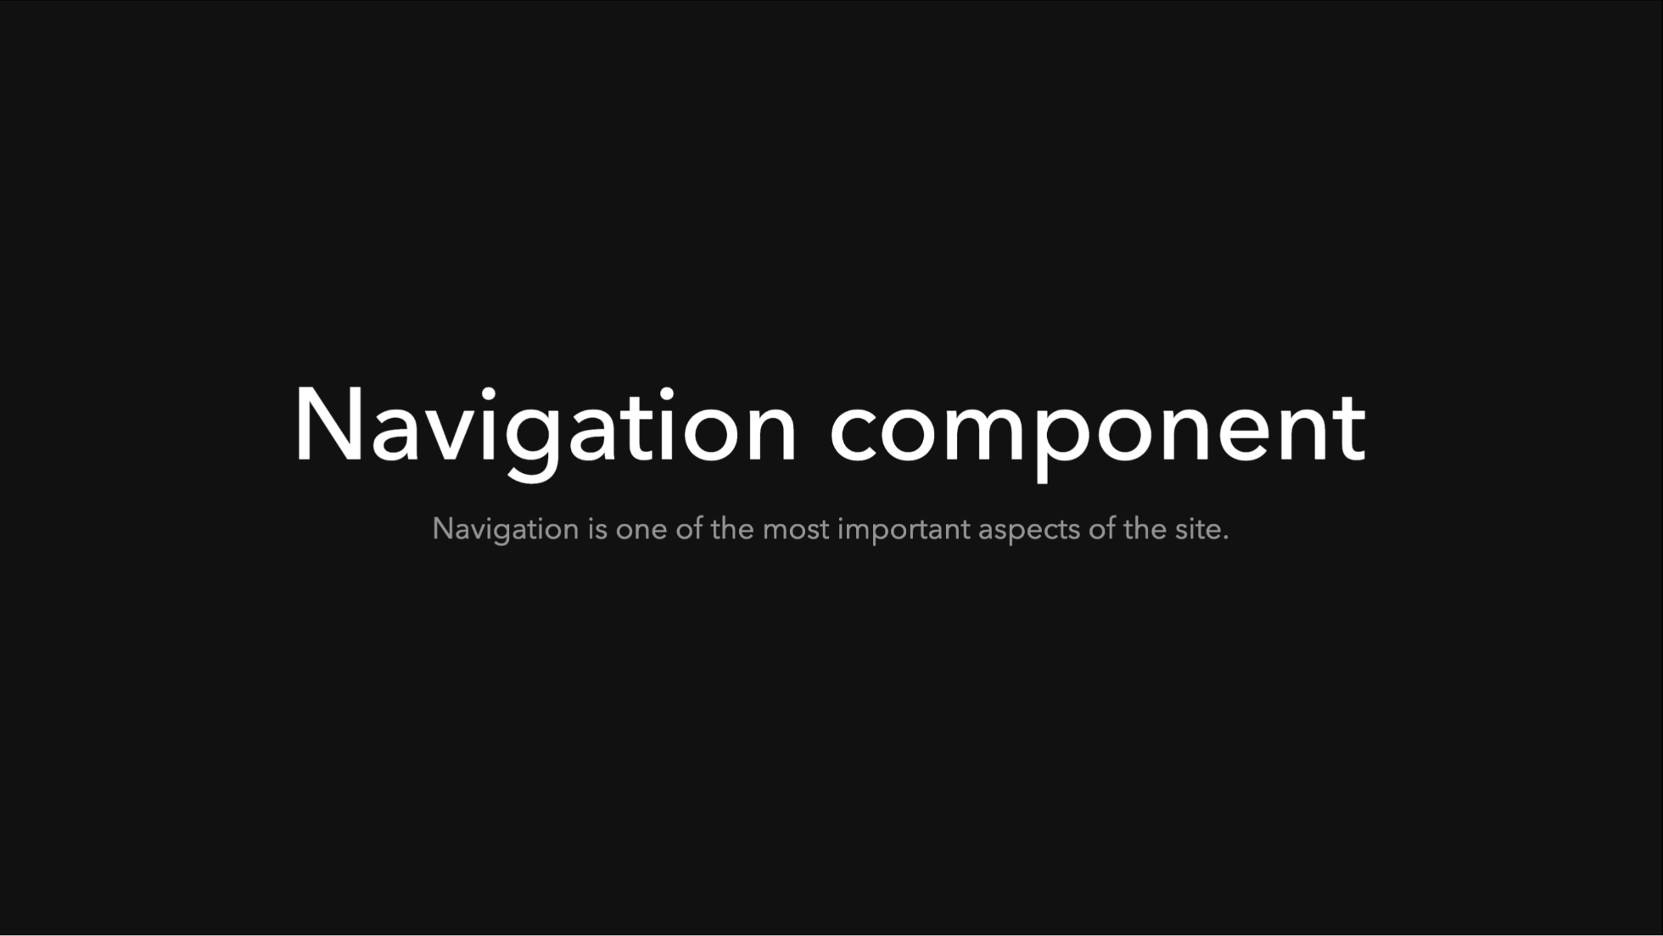

Slide 35
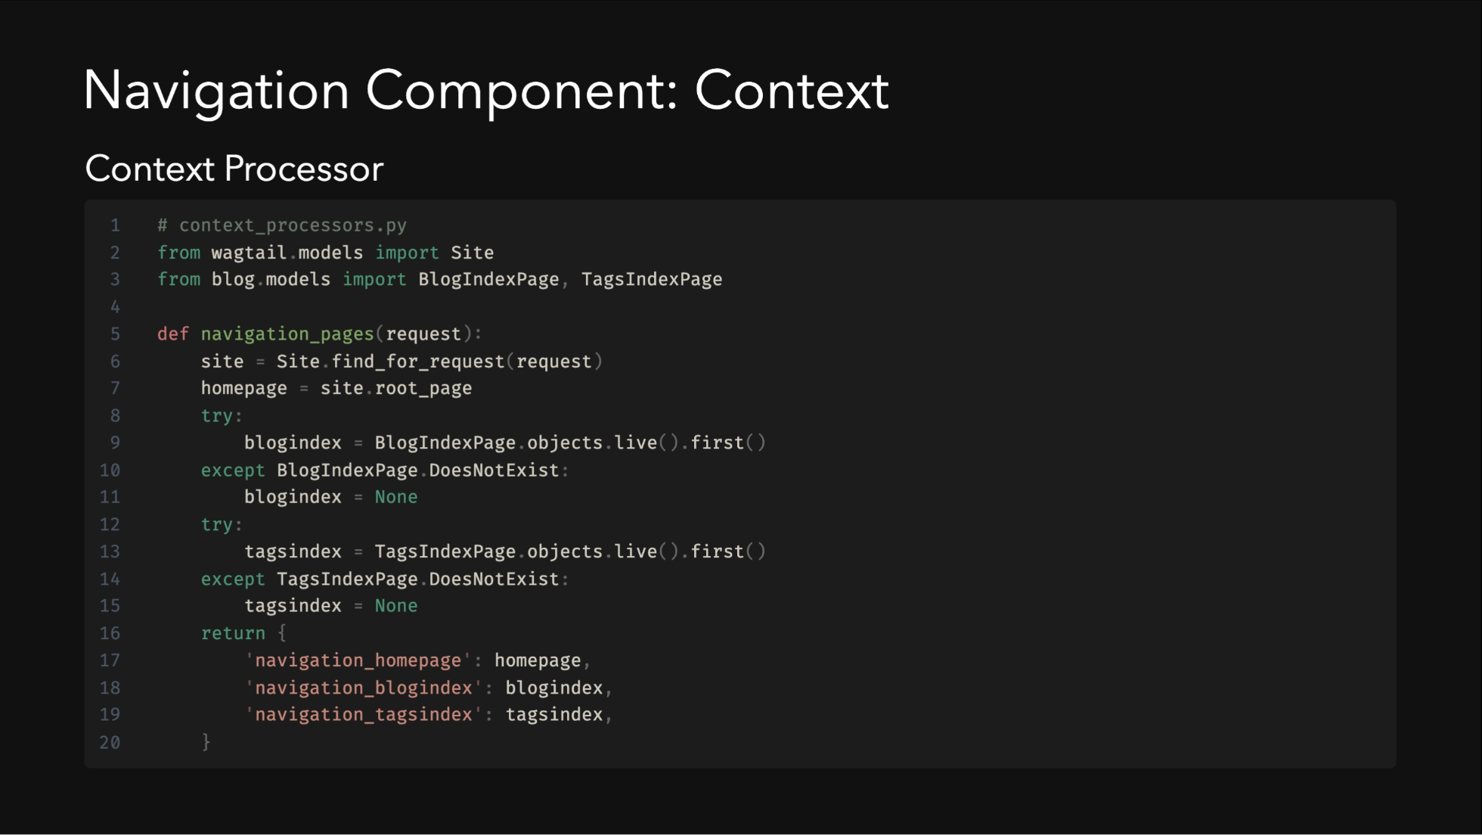

Slide 36
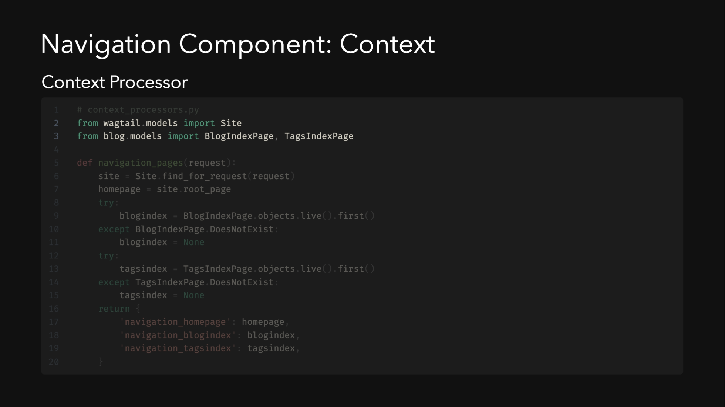

Slide 37
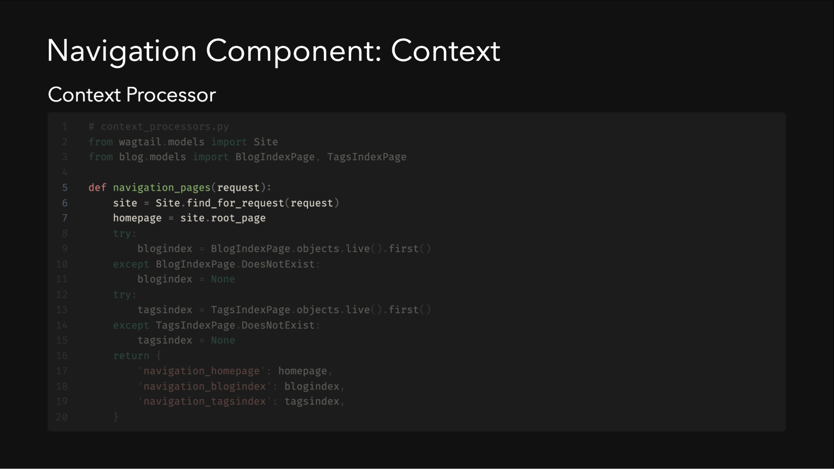

Slide 38
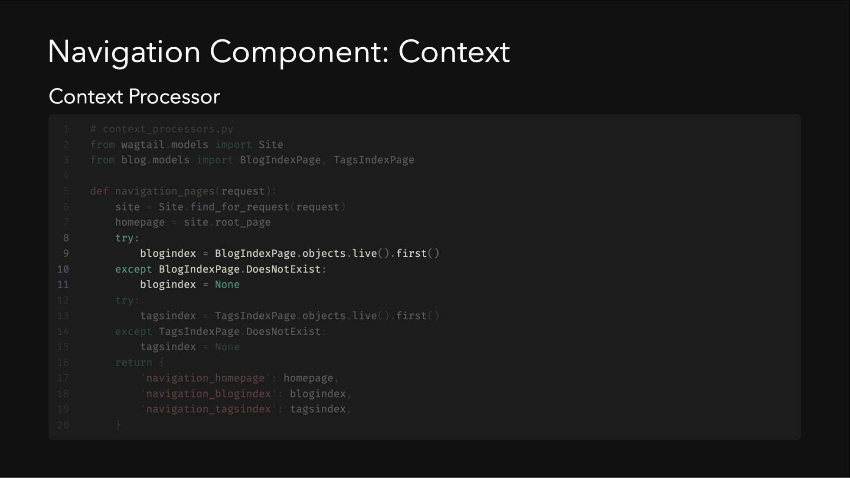

Slide 39
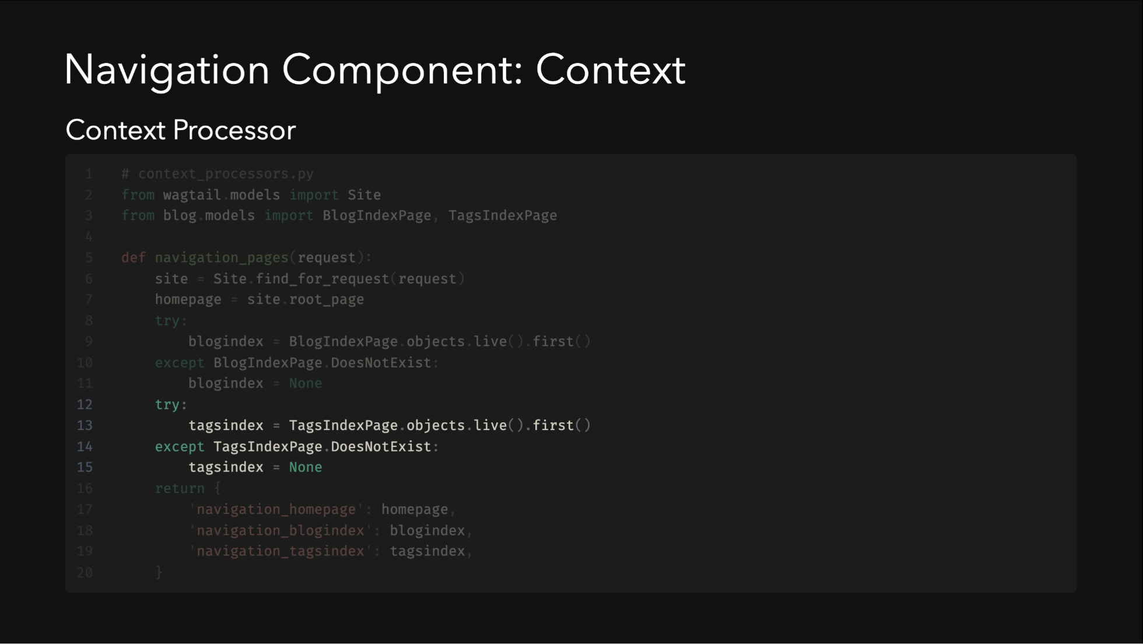

Slide 40
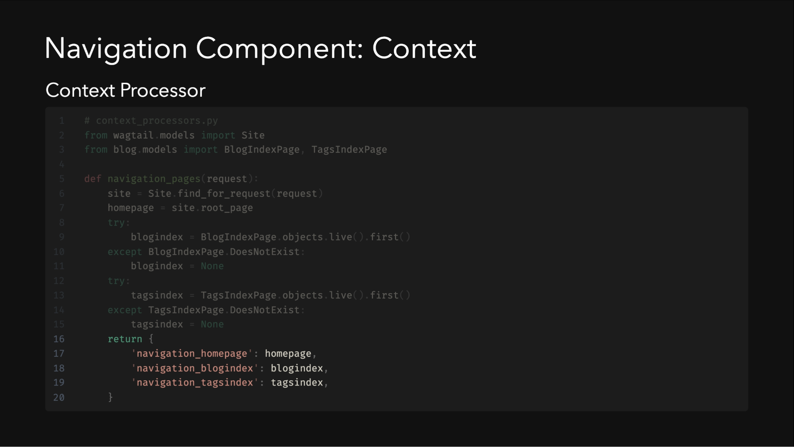

Slide 42
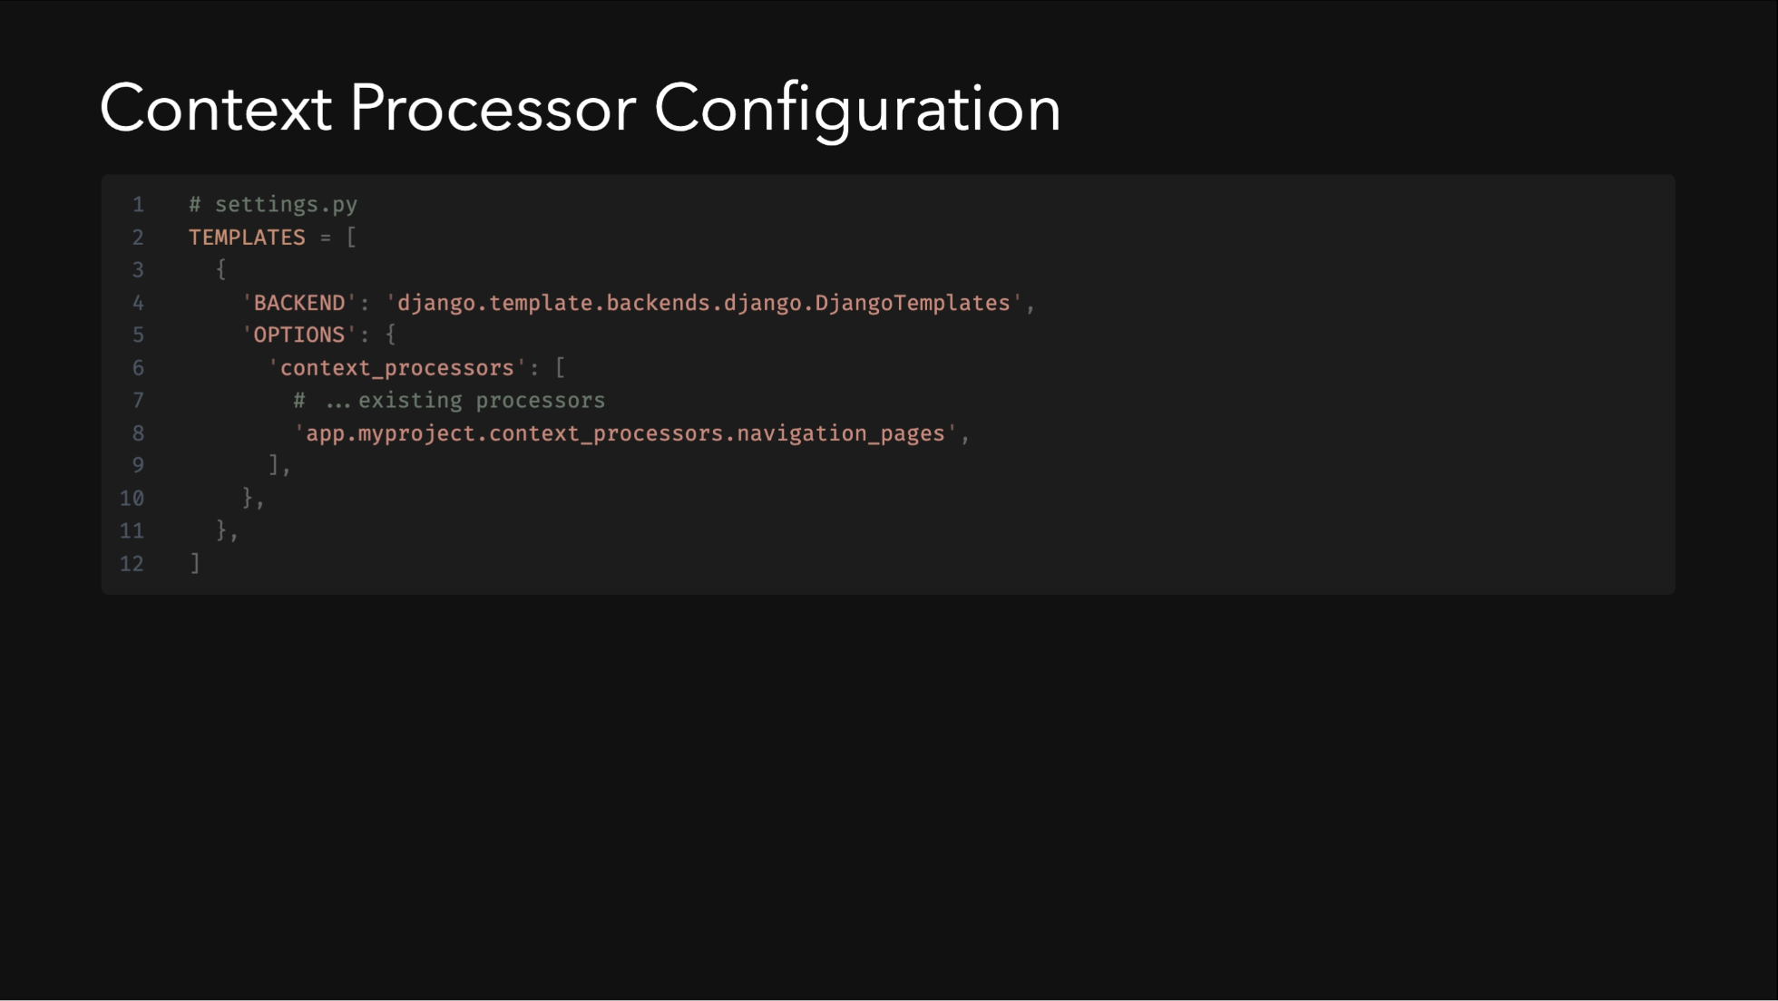
Notes:
The context processor provides navigation pages to all templates. It handles missing pages gracefully and uses Wagtail's site finder.

Slide 43
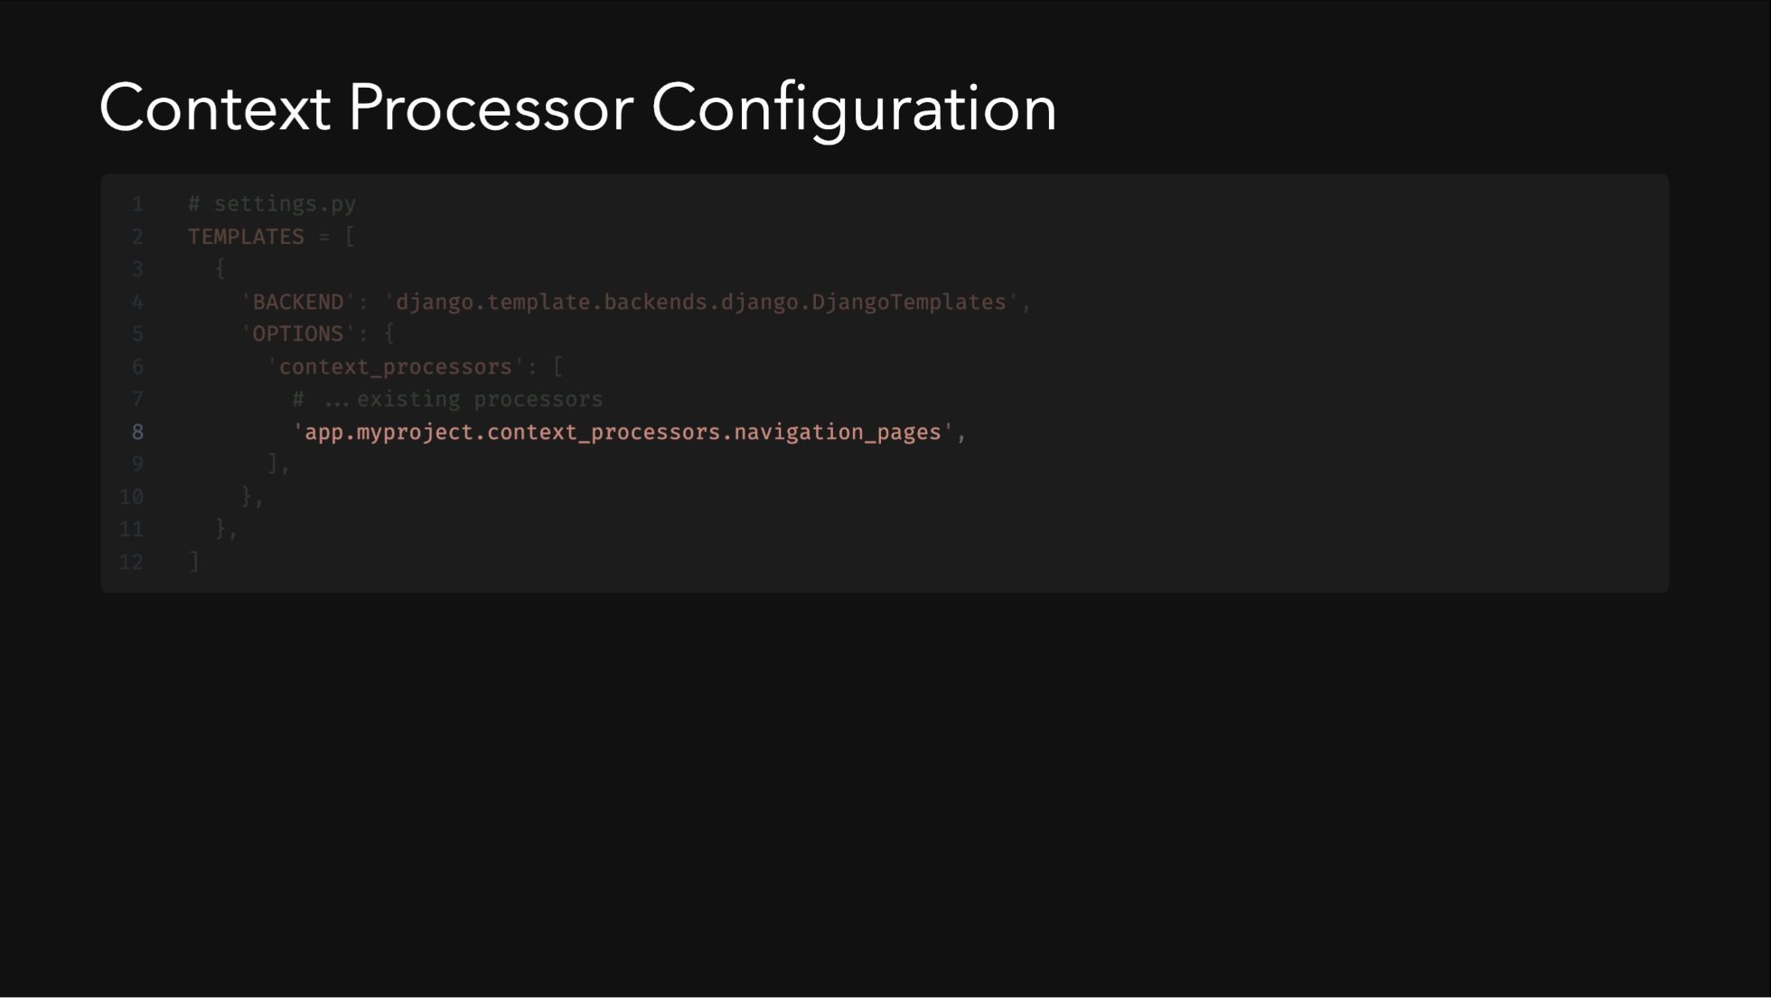
Notes:
The context processor provides navigation pages to all templates. It handles missing pages gracefully and uses Wagtail's site finder.

Slide 44
Notes:
The context processor provides navigation pages to all templates. It handles missing pages gracefully and uses Wagtail's site finder.

Slide 45
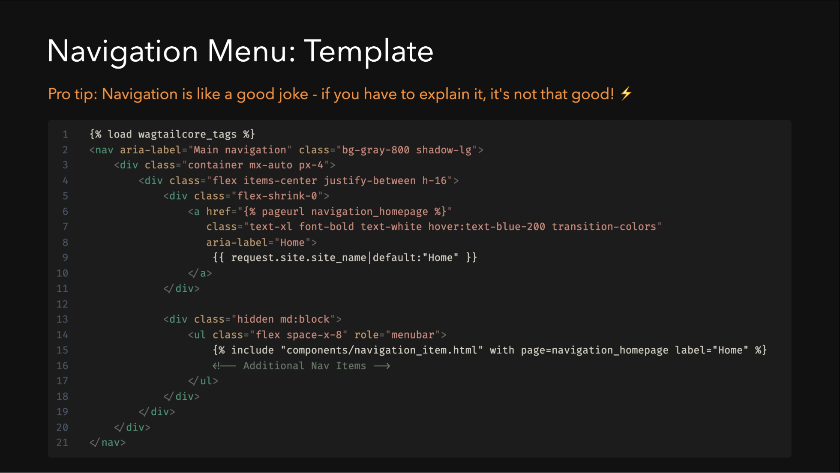
Notes:
- Responsive design with mobile menu - Dynamic navigation items from context - Active state highlighting - Dark mode support - Accessible button for mobile menu

Slide 46
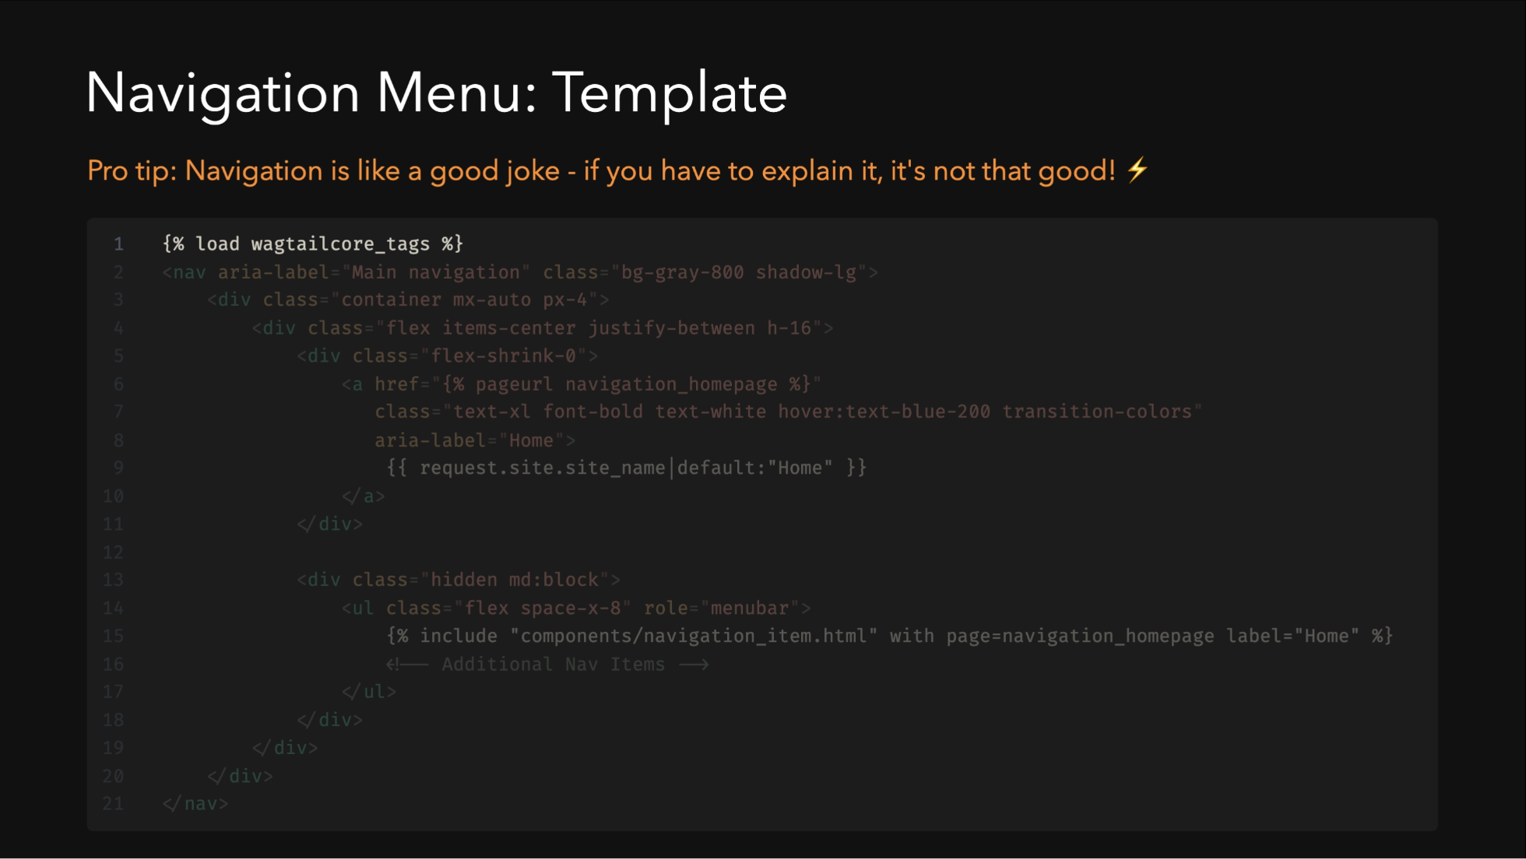
Notes:
- Responsive design with mobile menu - Dynamic navigation items from context - Active state highlighting - Dark mode support - Accessible button for mobile menu

Slide 47
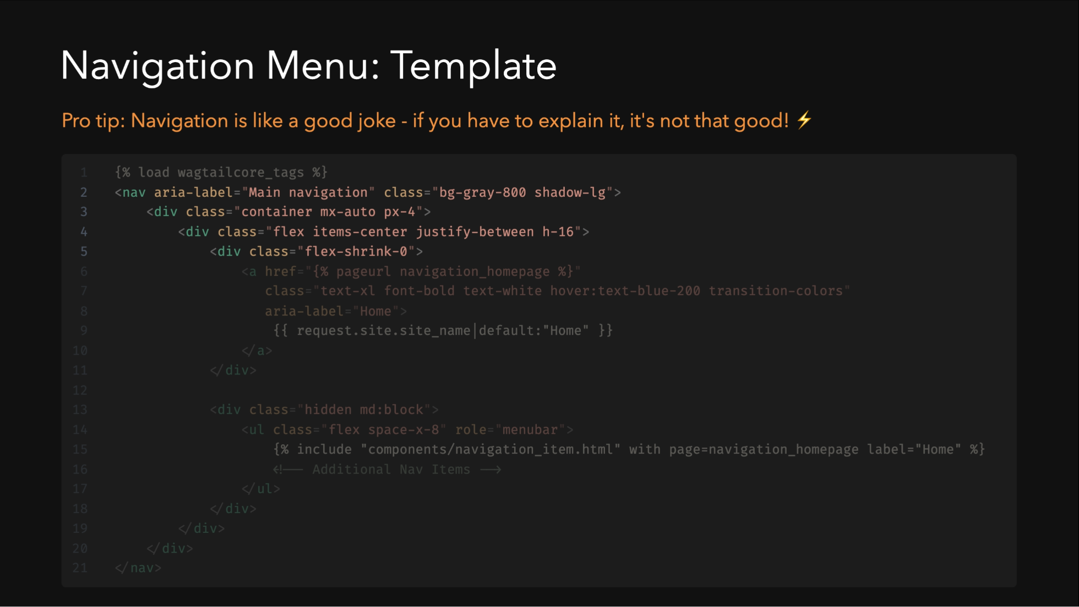
Notes:
- Responsive design with mobile menu - Dynamic navigation items from context - Active state highlighting - Dark mode support - Accessible button for mobile menu

Slide 48
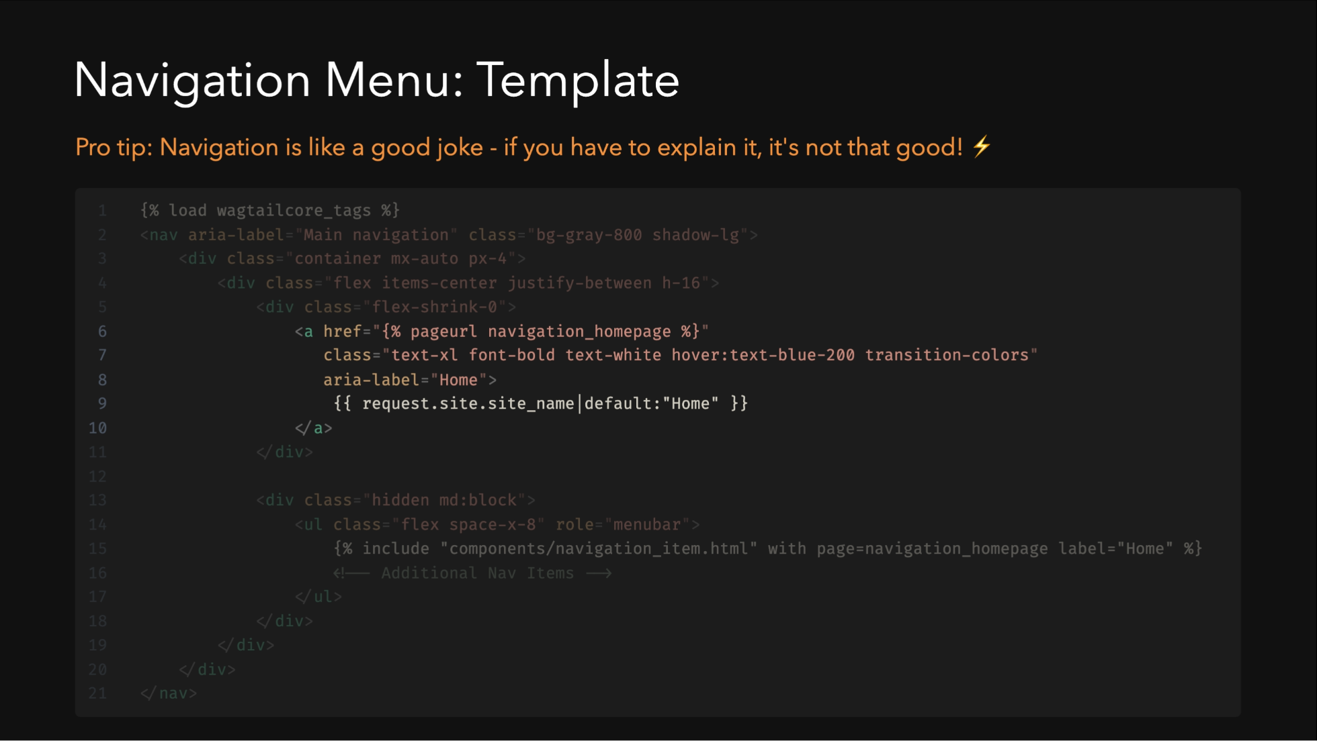
Notes:
- Responsive design with mobile menu - Dynamic navigation items from context - Active state highlighting - Dark mode support - Accessible button for mobile menu

Slide 49
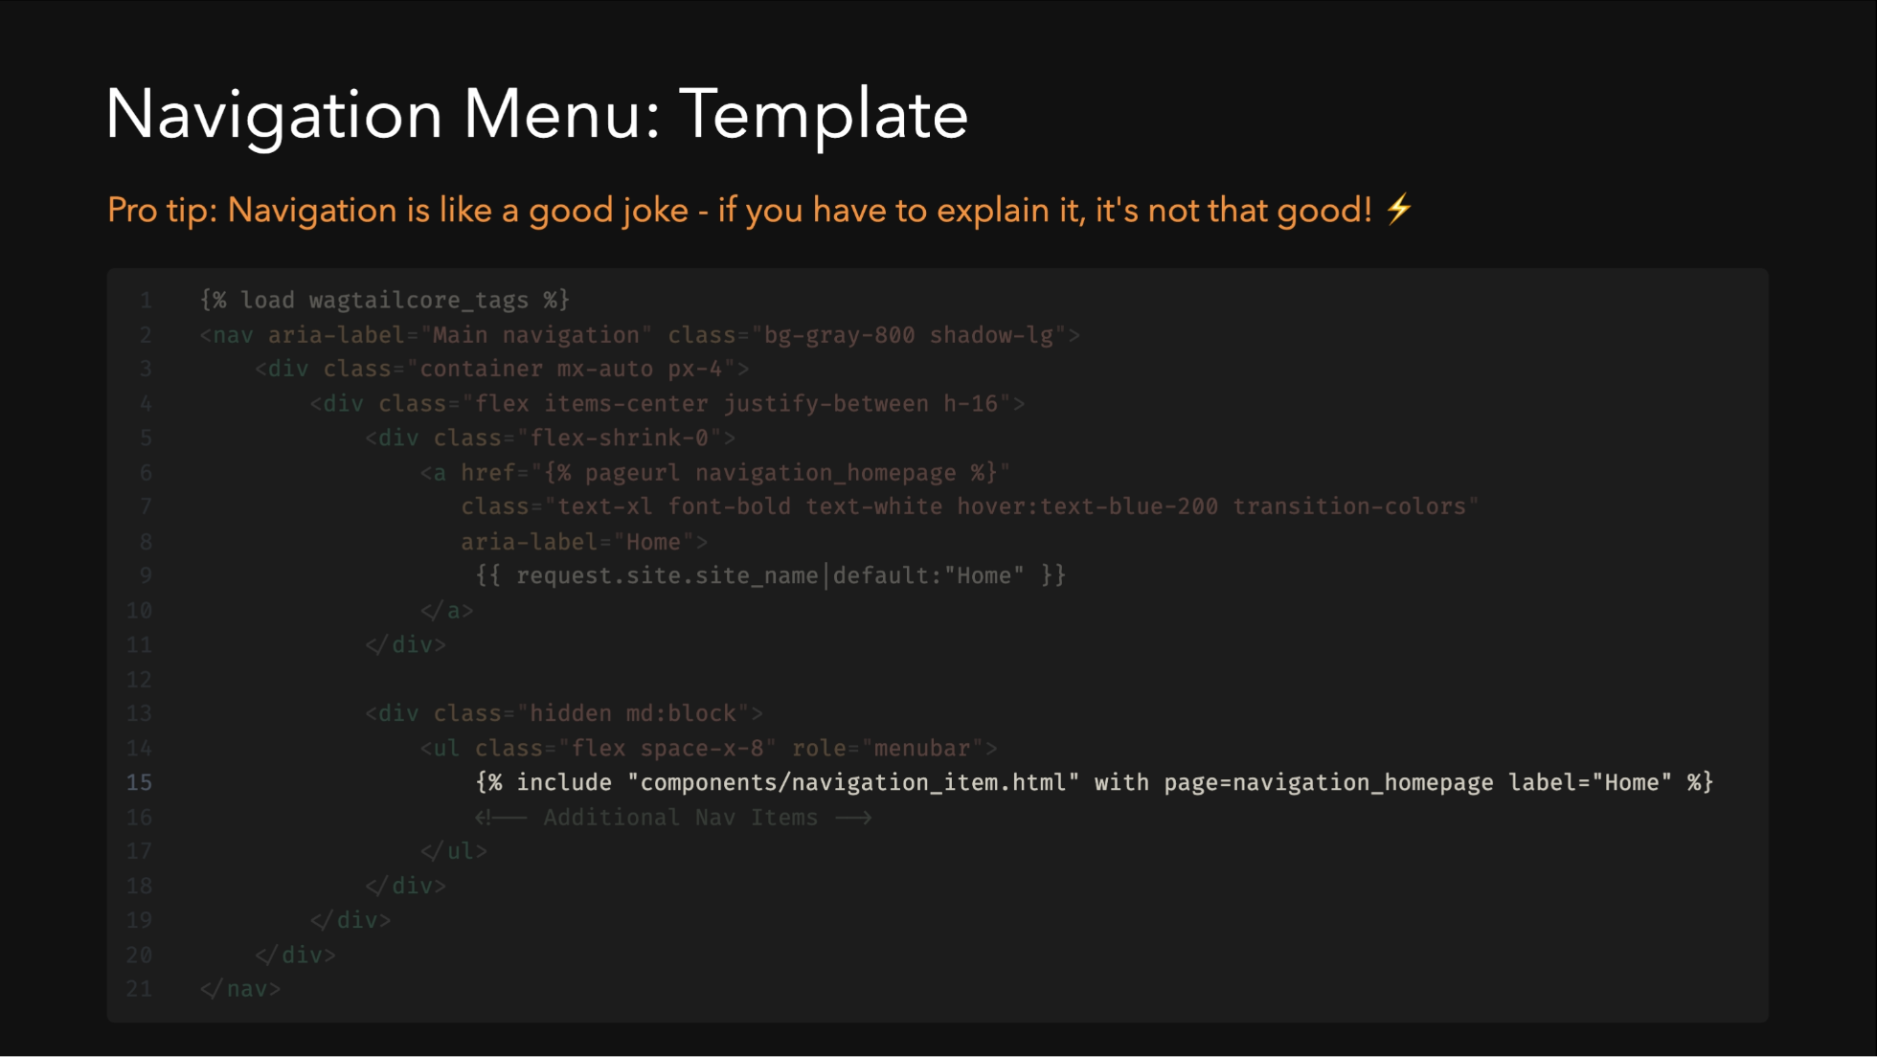
Notes:
- Responsive design with mobile menu - Dynamic navigation items from context - Active state highlighting - Dark mode support - Accessible button for mobile menu

Slide 50
Notes:
- Responsive design with mobile menu - Dynamic navigation items from context - Active state highlighting - Dark mode support - Accessible button for mobile menu

Slide 51
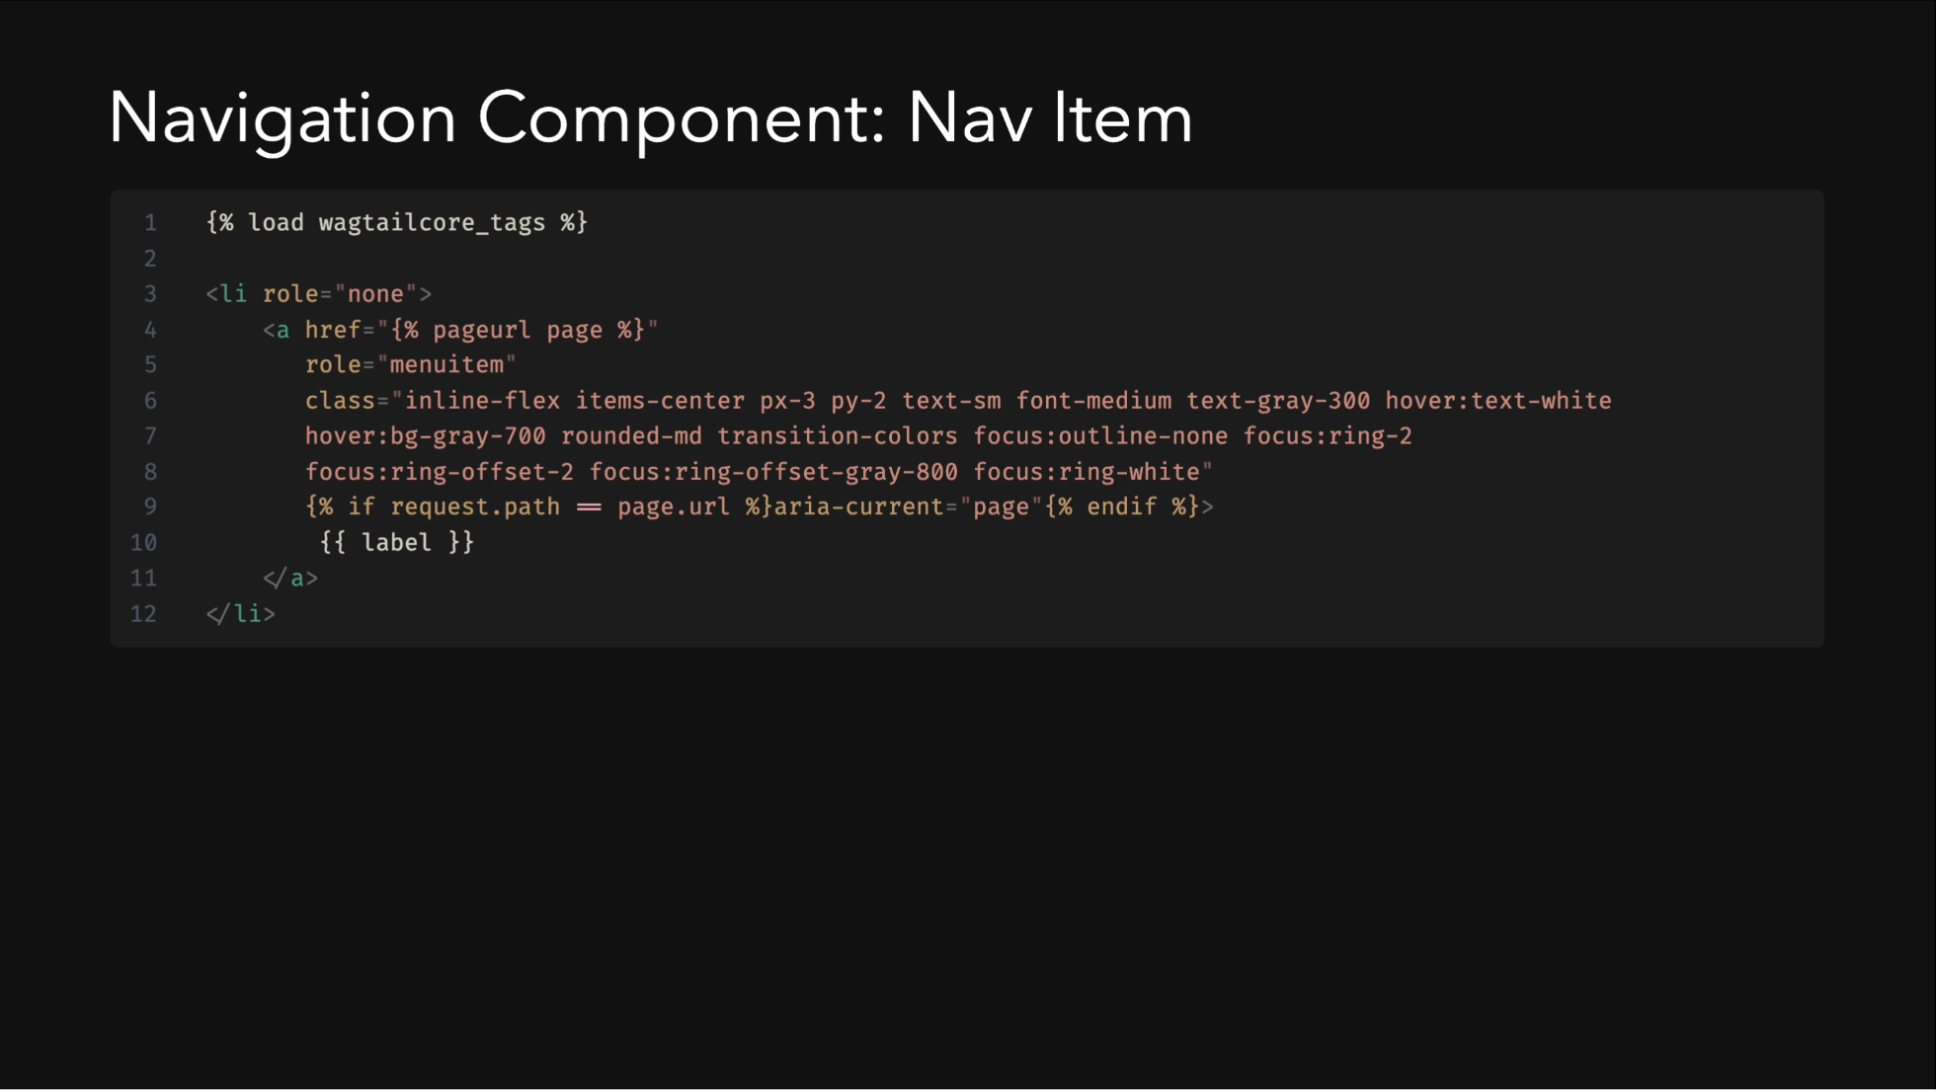

Slide 52
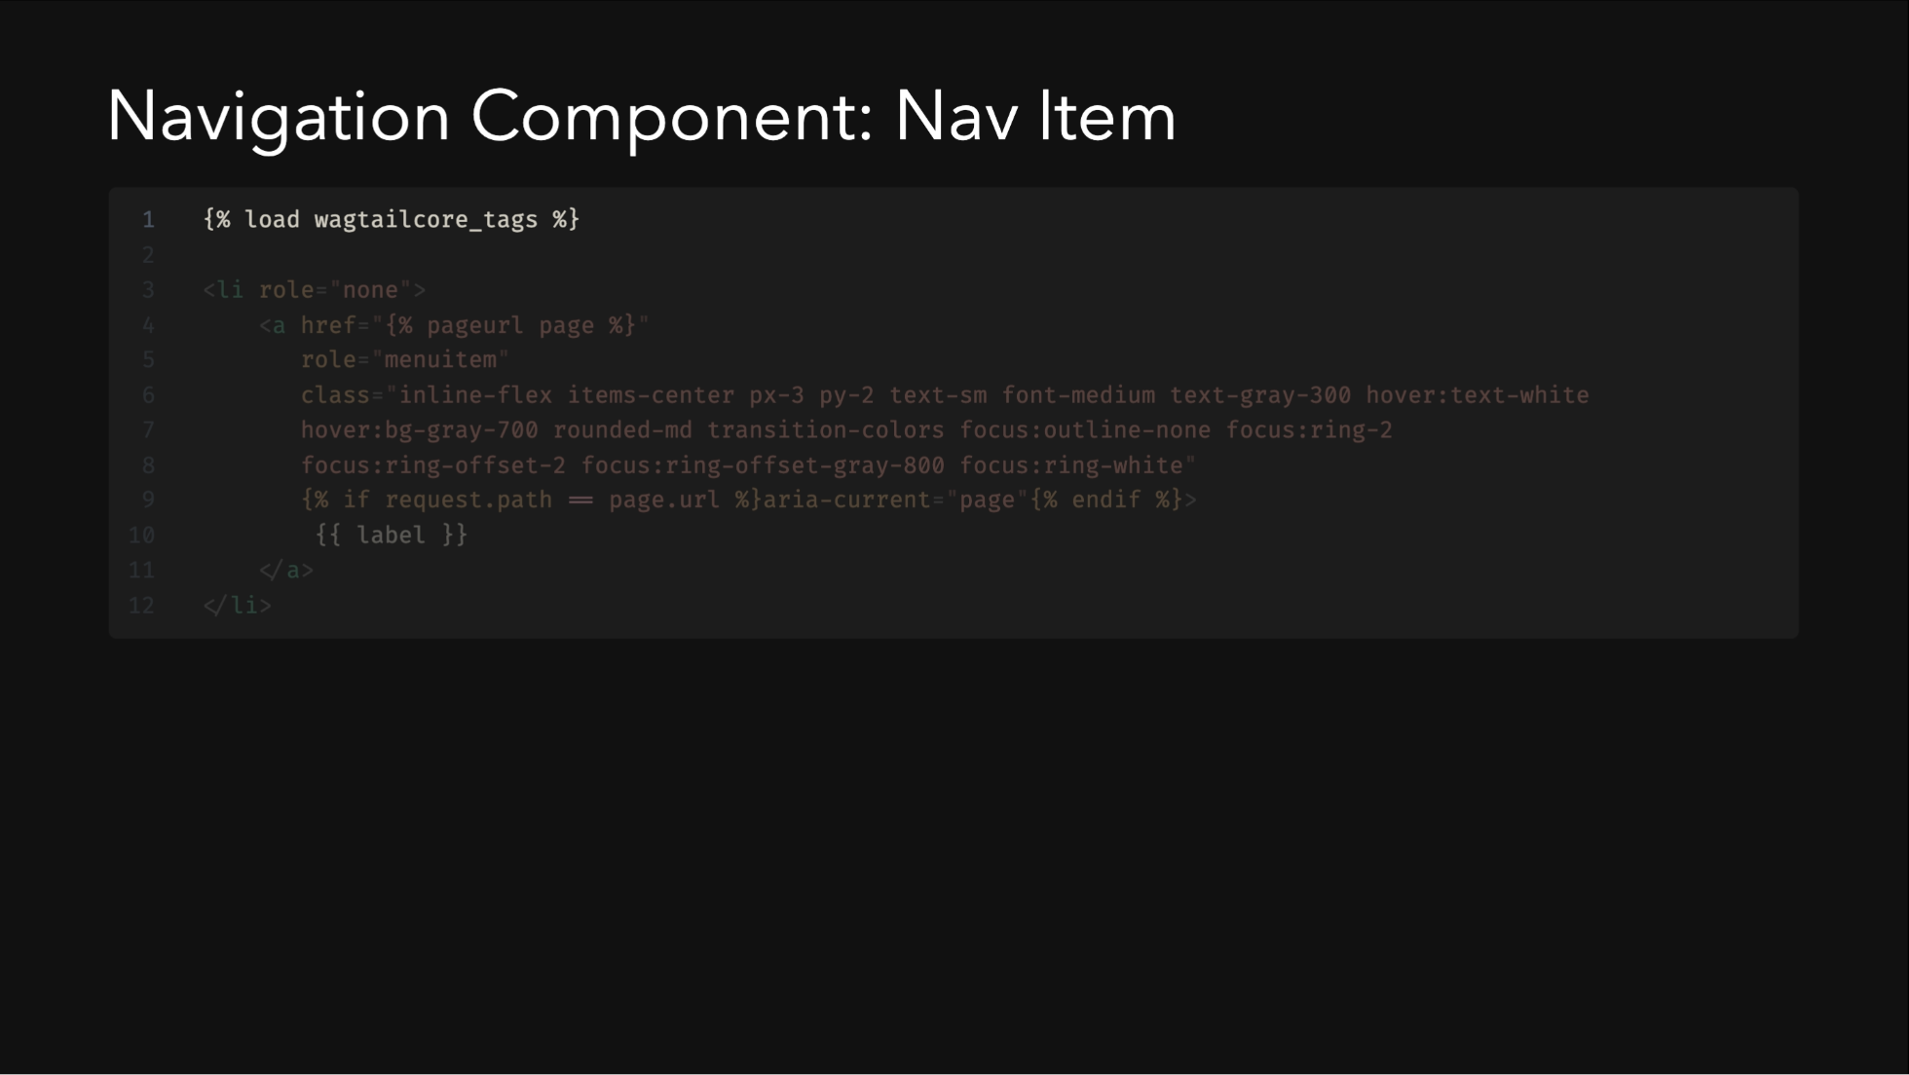

Slide 53
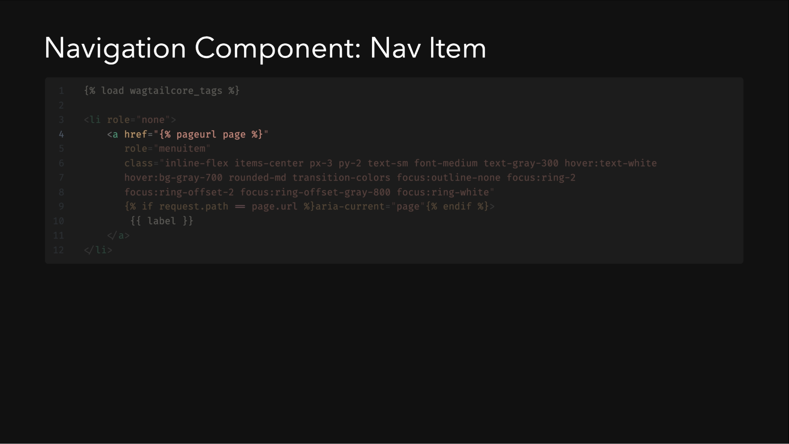

Slide 54
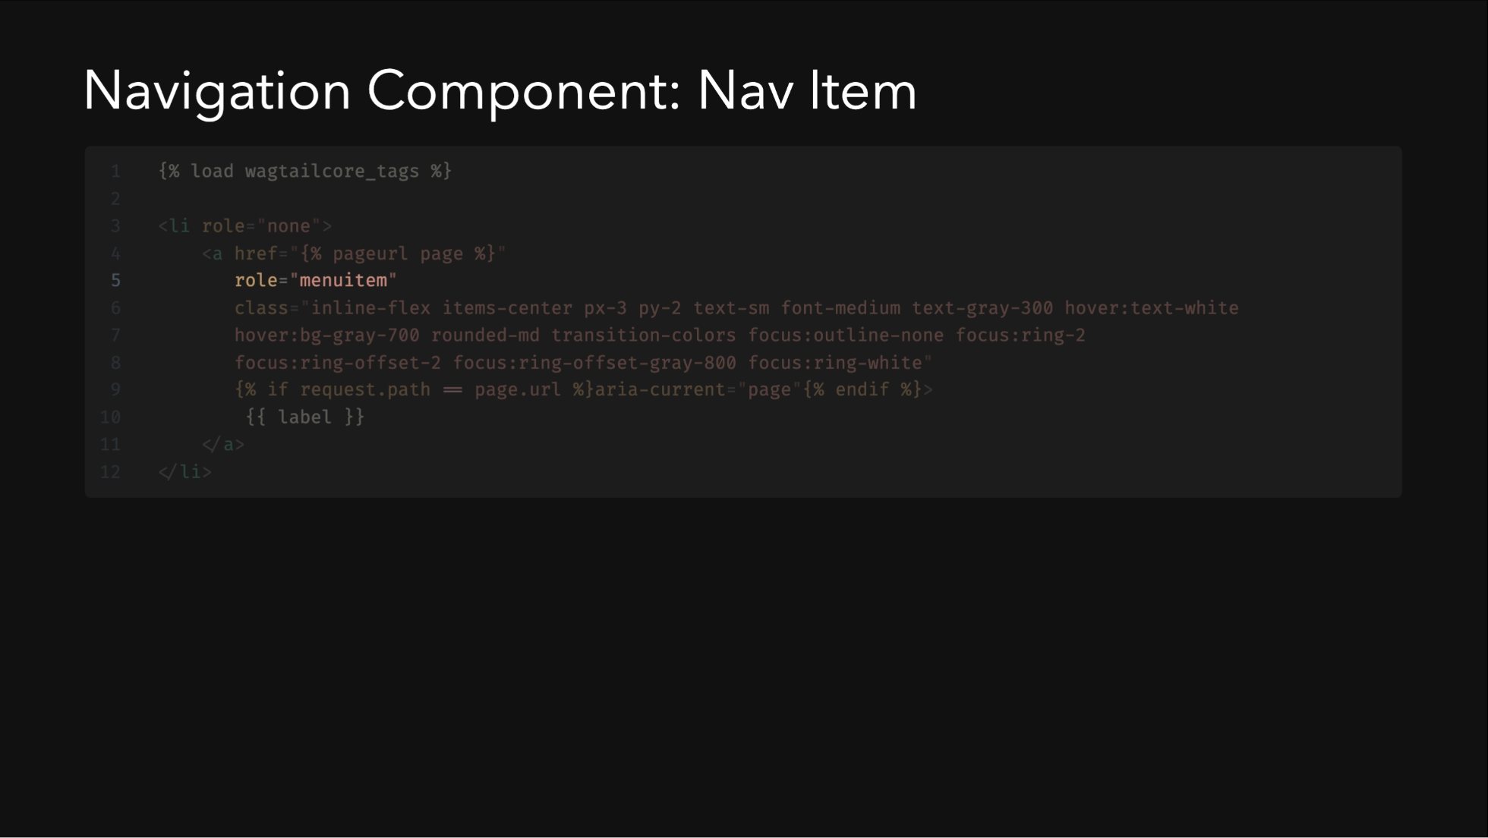

Slide 55
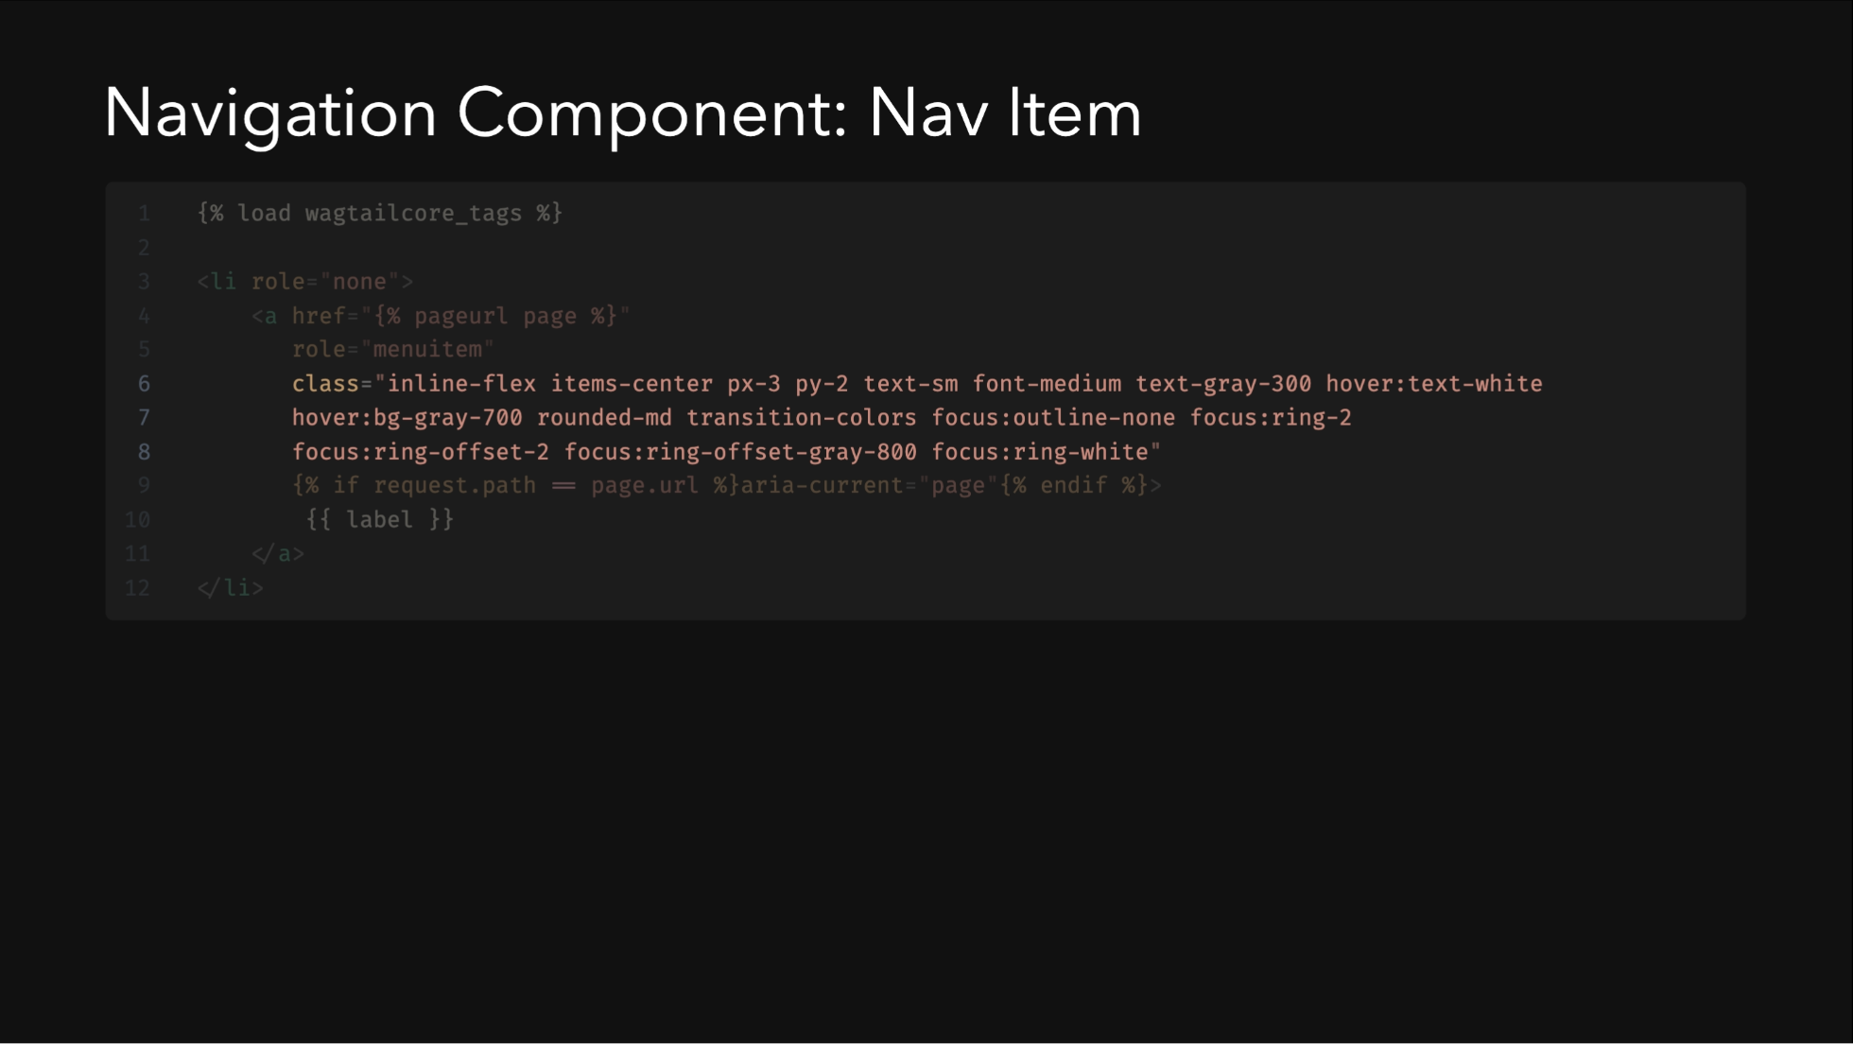

Slide 56


Slide 58

Notes:
The Wagtail admin interface provides a powerful yet user-friendly environment for content editors. The page hierarchy is central to Wagtail's content organization system.

Slide 59

Notes:
This concludes our tutorial, but there are many ways to extend and enhance your Wagtail-Tailwind blog. The resources listed will help you continue your learning journey.

